Slide 1
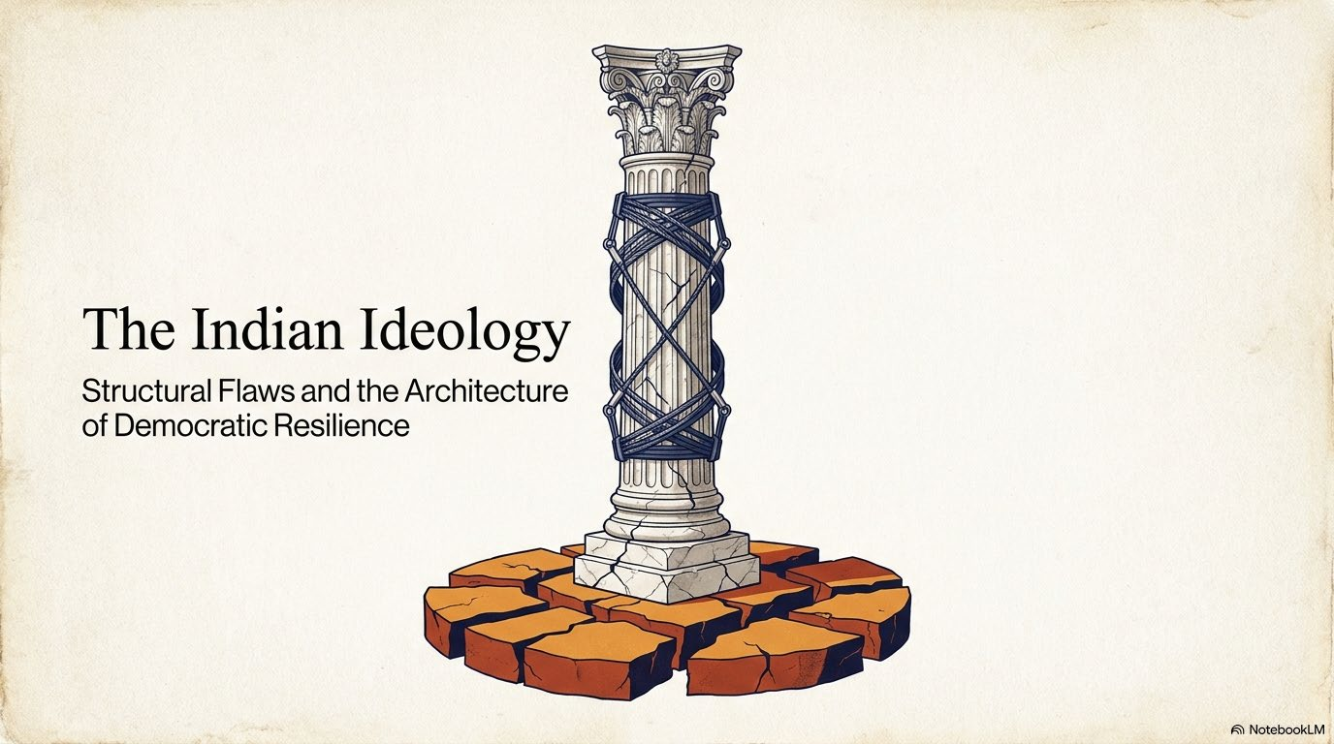

Slide 2


Perry Anderson’s India trilogy became The Indian Ideology in 2012
Three essays published consecutively in the London Review of Books
5 JULY 2012
19 JULY 2012
2 AUGUST 2012
Gandhi Centre Stage
Critiques Gandhi’s use of religion in mass politics and the nationalist movement.
Why Partition?
Reassesses Congress, the Muslim League, British rule, and responsibility for Partition.
After Nehru
Examines Nehru’s legacy and the interaction of democracy, caste, religion, and inequality.
BOOK PUBLICATION
Later in 2012, the essays were collected as The Indian Ideology by Three Essays Collective.
Perry Anderson • British historian and political theorist
1

Slide 3
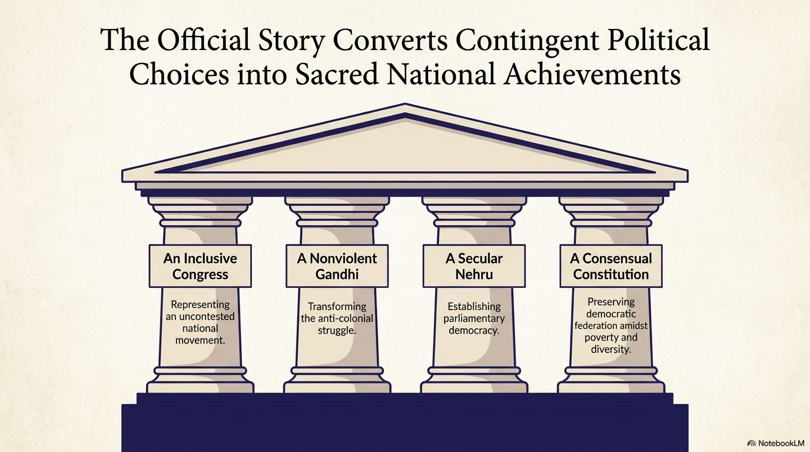

Slide 4
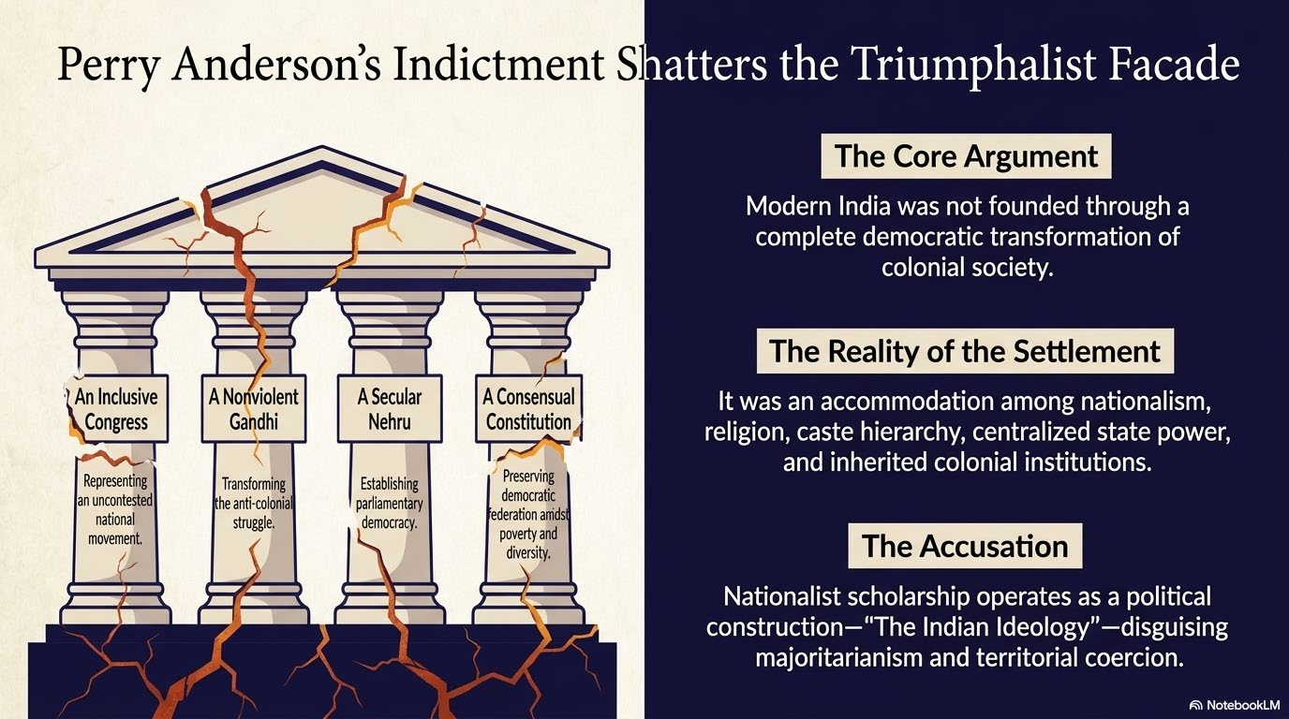

Slide 5
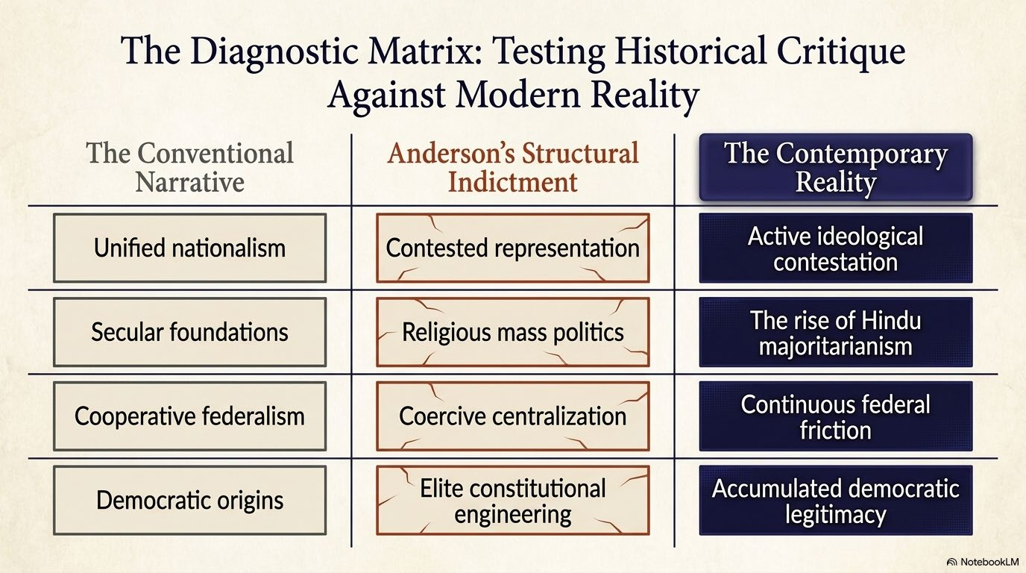

Slide 6
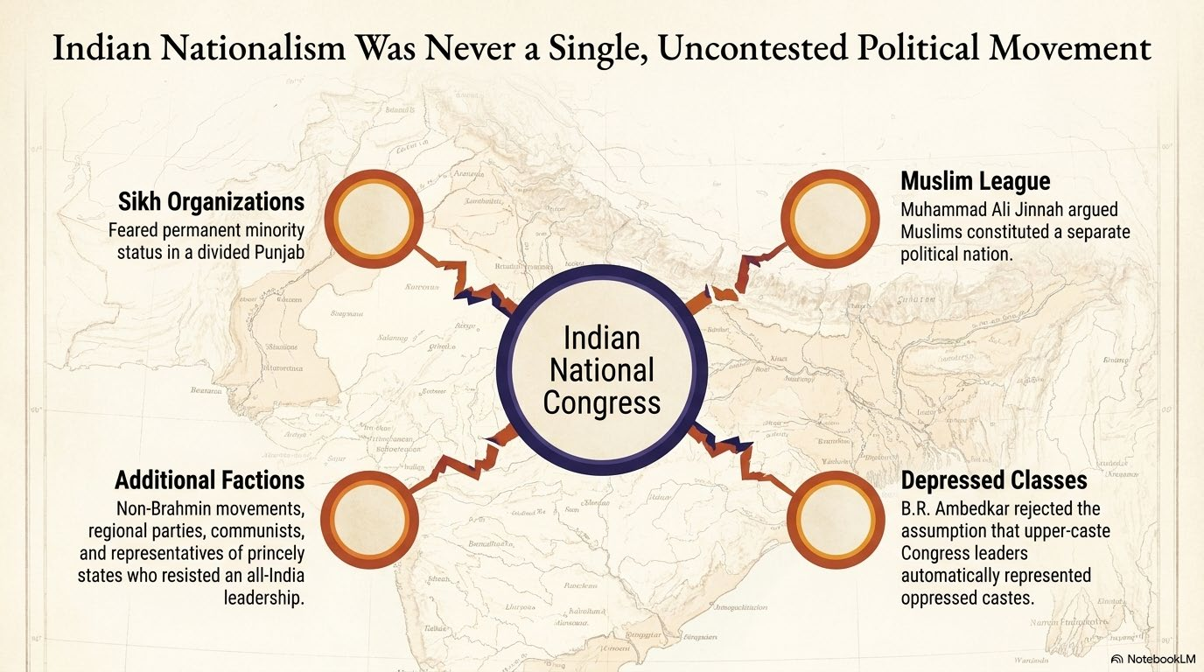

Slide 7
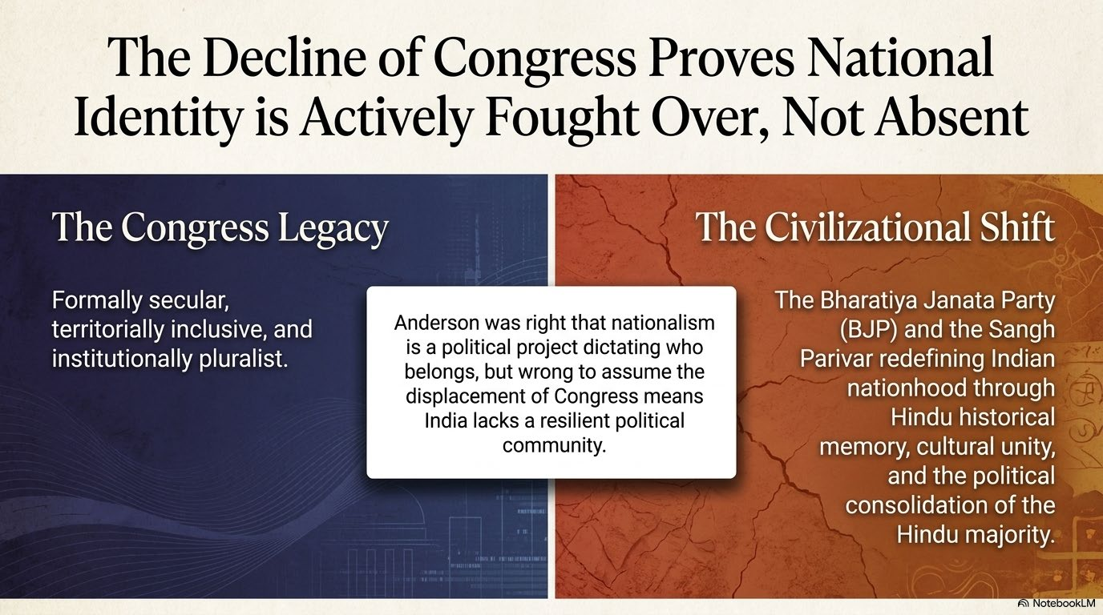

Slide 8
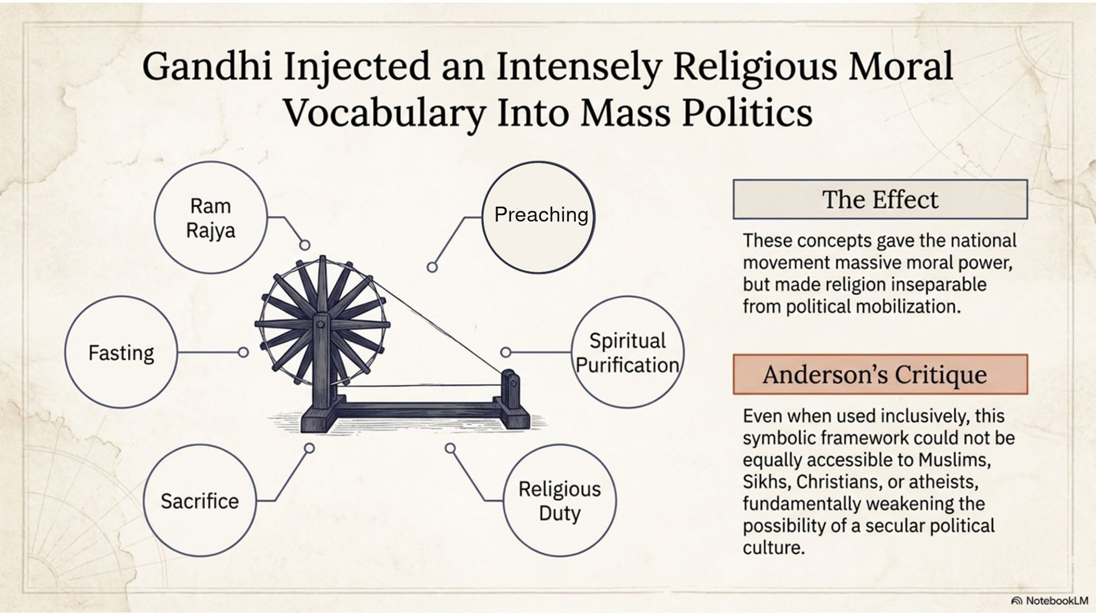

Slide 9
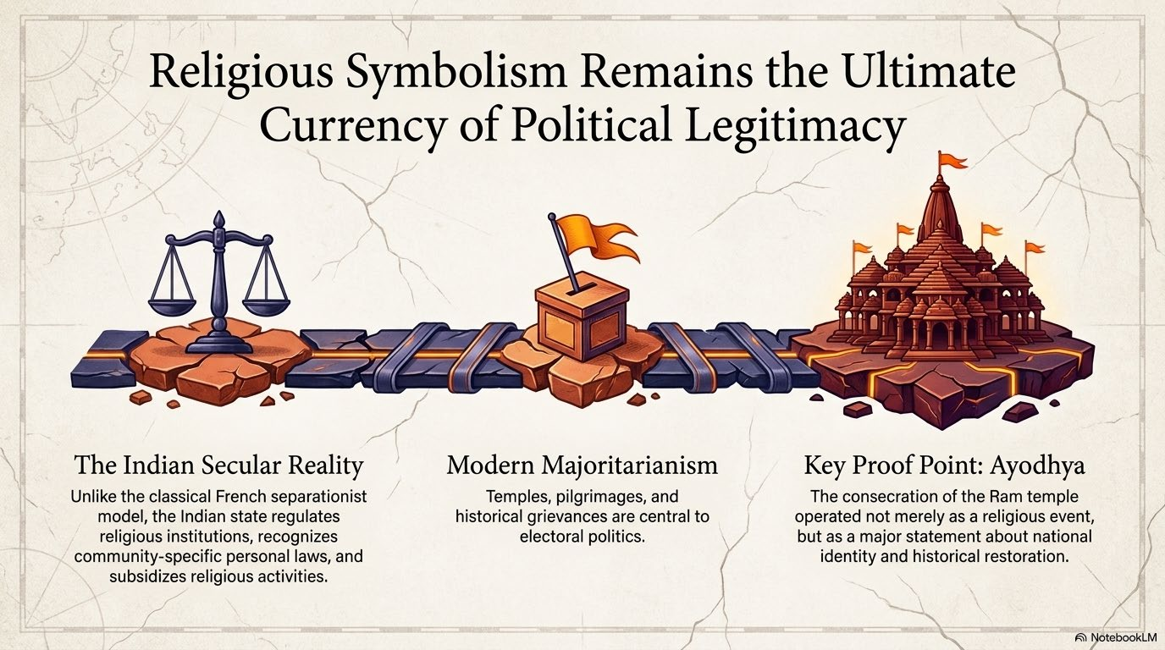

Slide 10
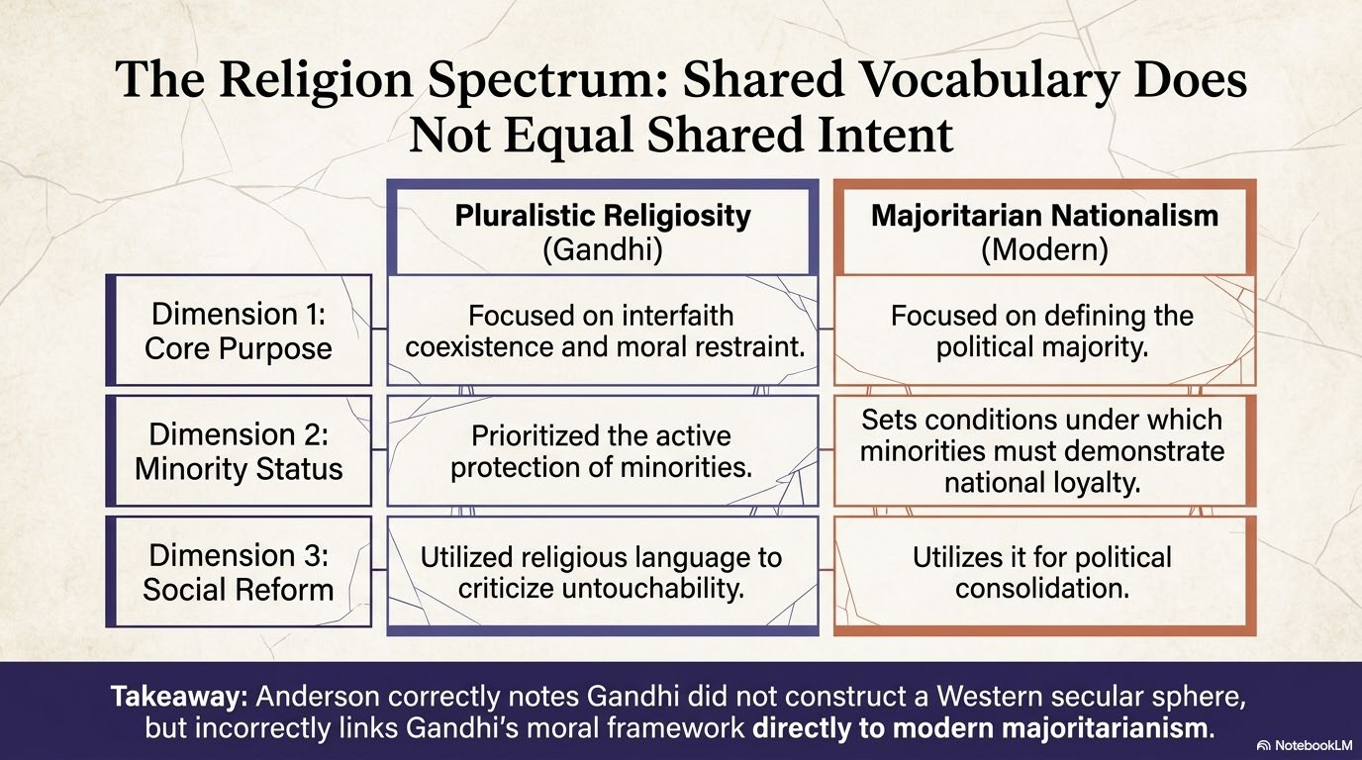

Slide 11
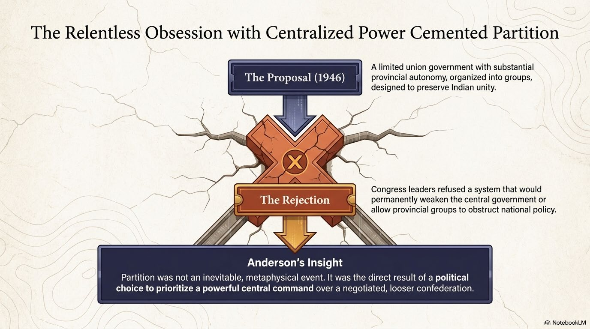

Slide 12
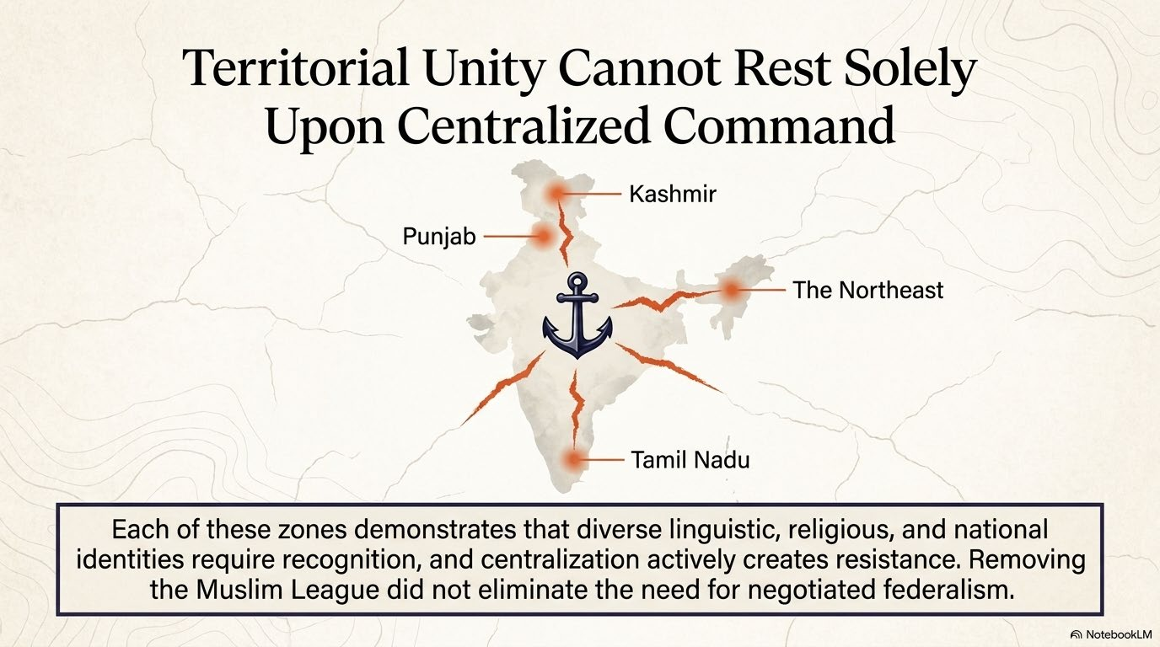

Slide 13
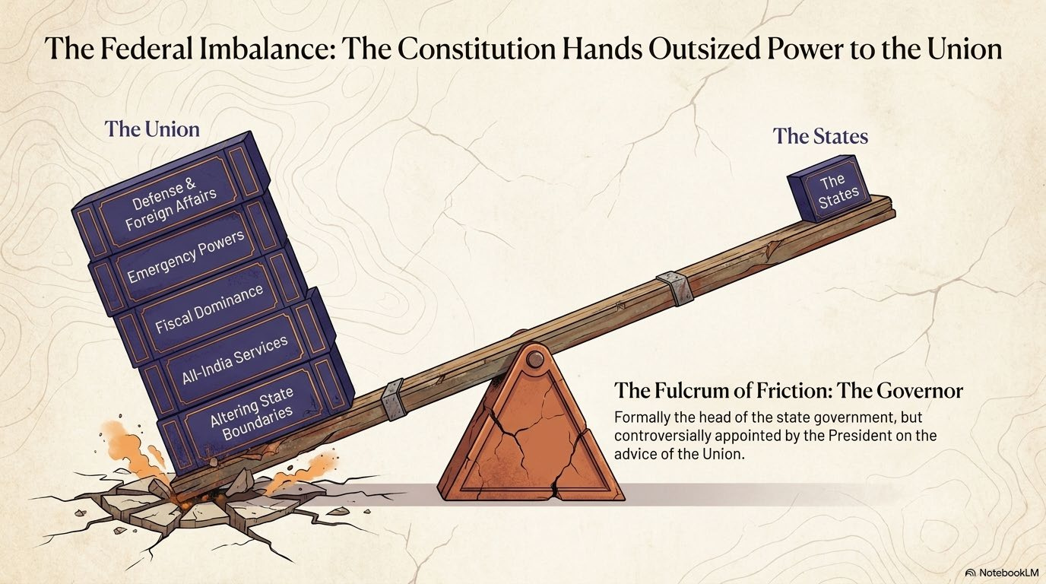

Slide 14
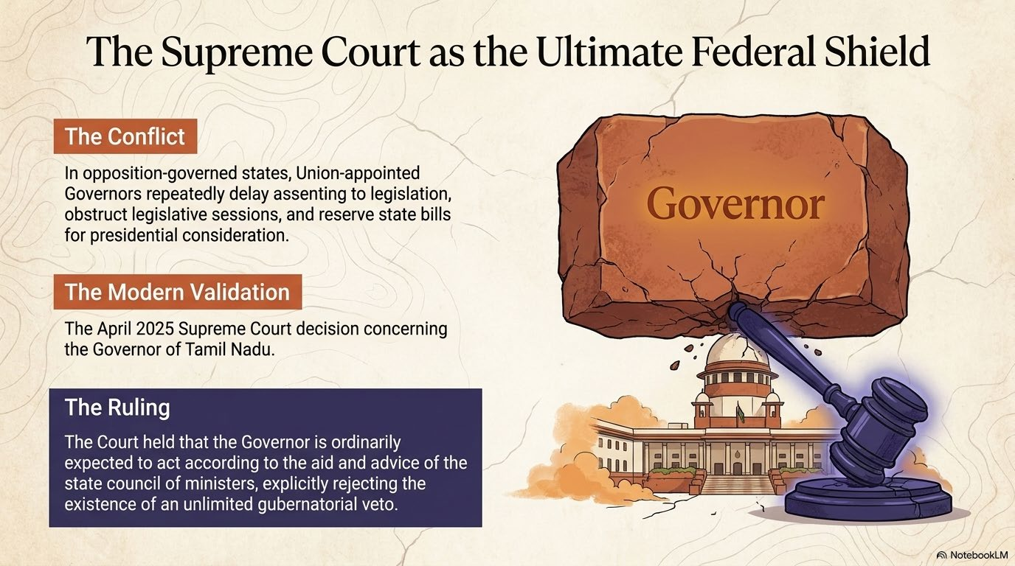

Slide 15
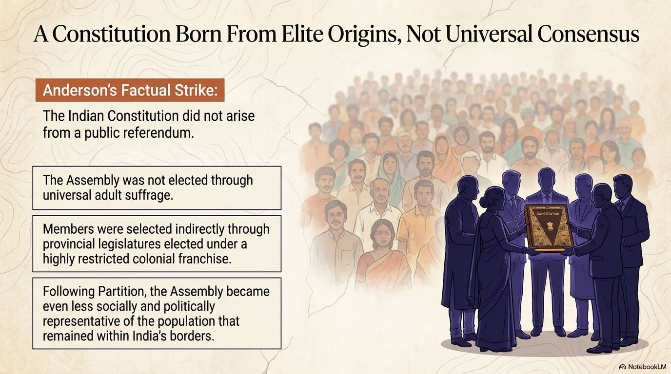

Slide 16
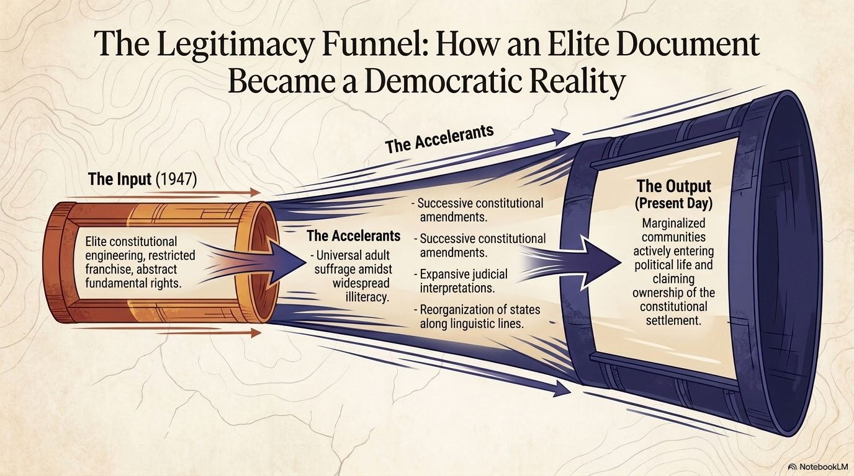

Slide 17
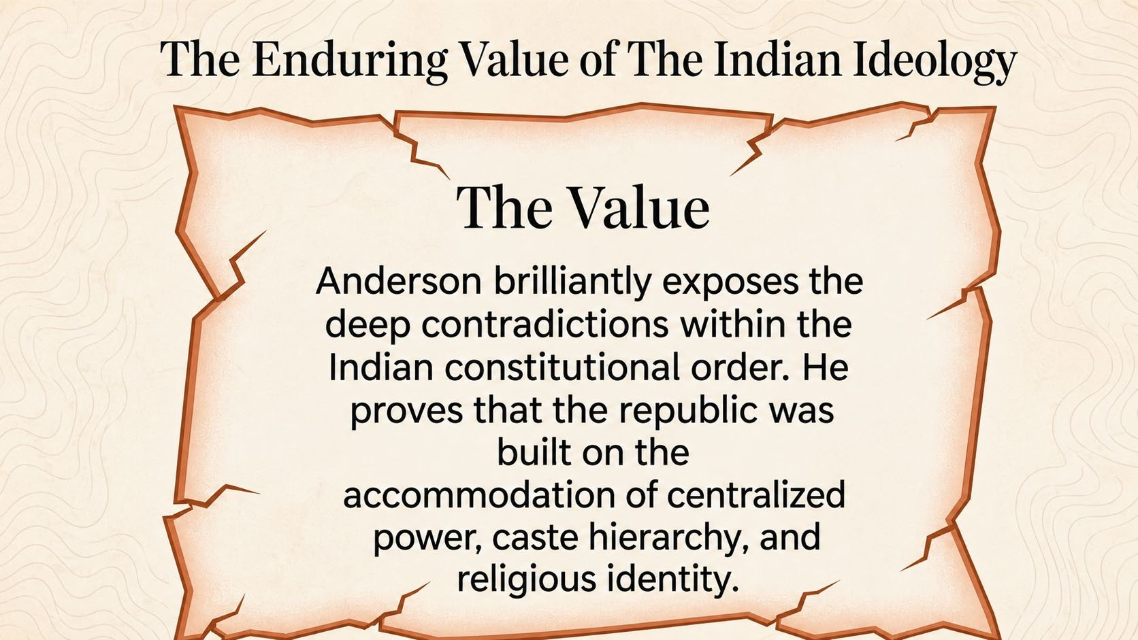

Slide 18
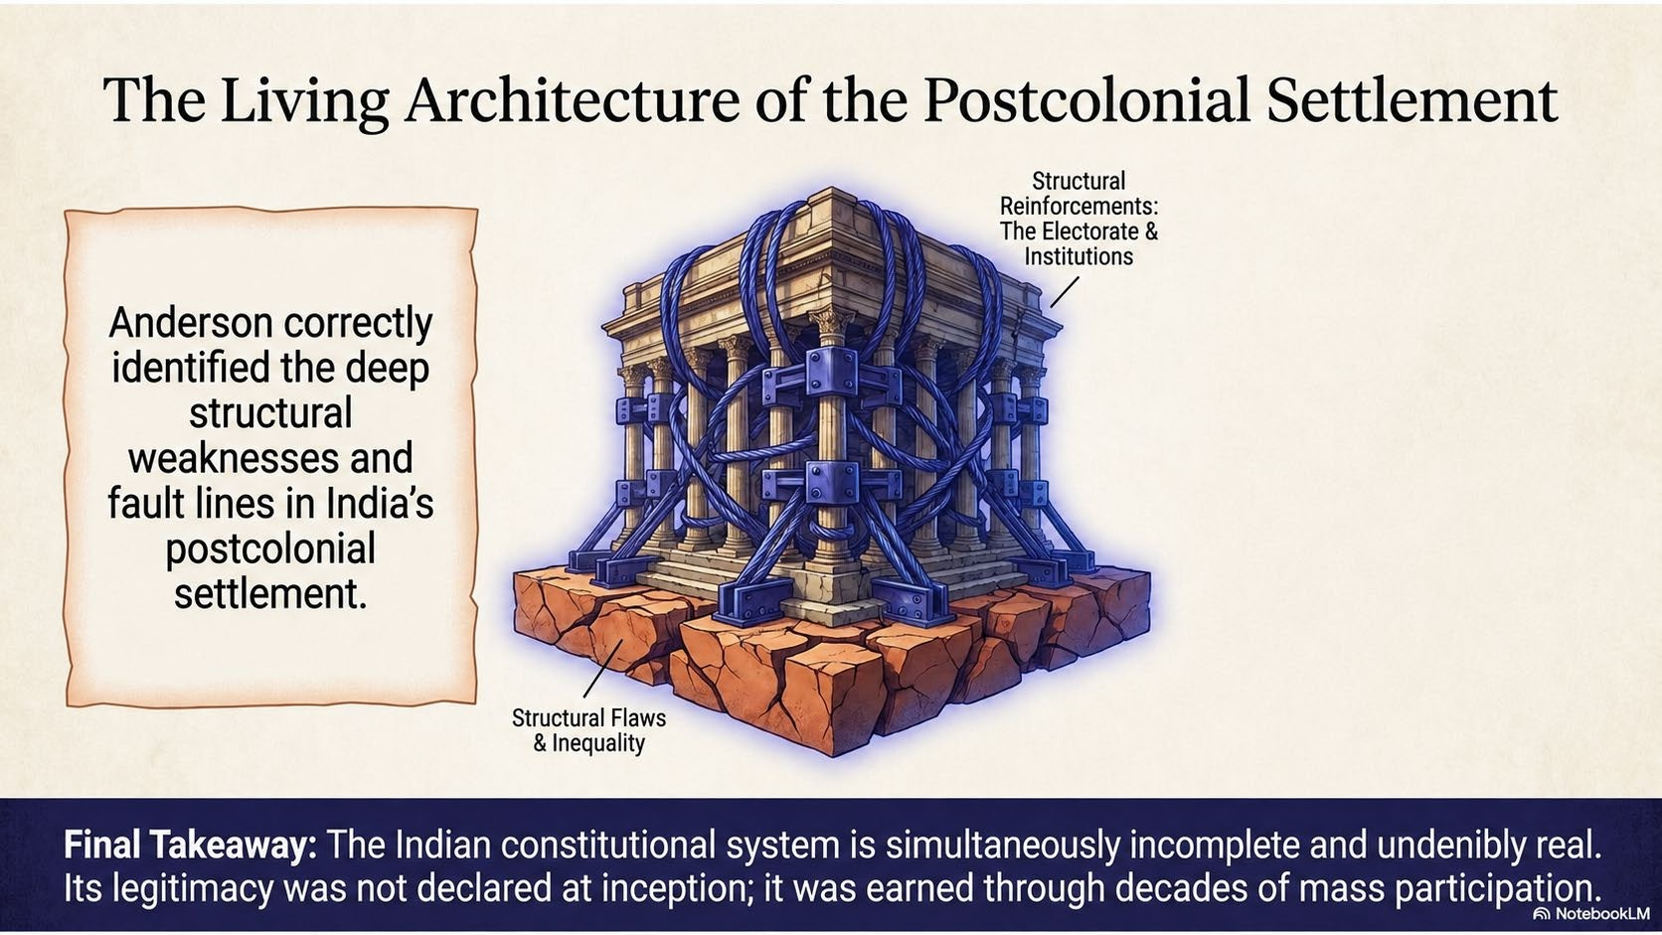

Slide 19
India’s National Narrative—Reconsidered
Perry Anderson, The Indian Ideology
CONVENTIONAL NARRATIVE | ANDERSON’S REINTERPRETATION
India possessed an ancient national unity. | Modern political unity was substantially created under British rule.
Gandhi’s nonviolence defeated British rule. | Gandhi built a mass party; war and imperial decline proved decisive.
Jinnah alone caused Partition. | Congress centralism and rejected power-sharing also contributed.
India is naturally secular. | Nationalism was deeply infused with Hindu religious symbolism.
The Constitution broke with colonialism. | It retained many colonial institutions and coercive powers.
Caste contradicts democracy. | Caste also stabilized democracy by dividing disadvantaged groups.
National unity reflects popular consent. | In Kashmir and the Northeast, unity was often maintained through force.
Source: Perry Anderson, The Indian Ideology (Verso, 2013)
1

Slide 20
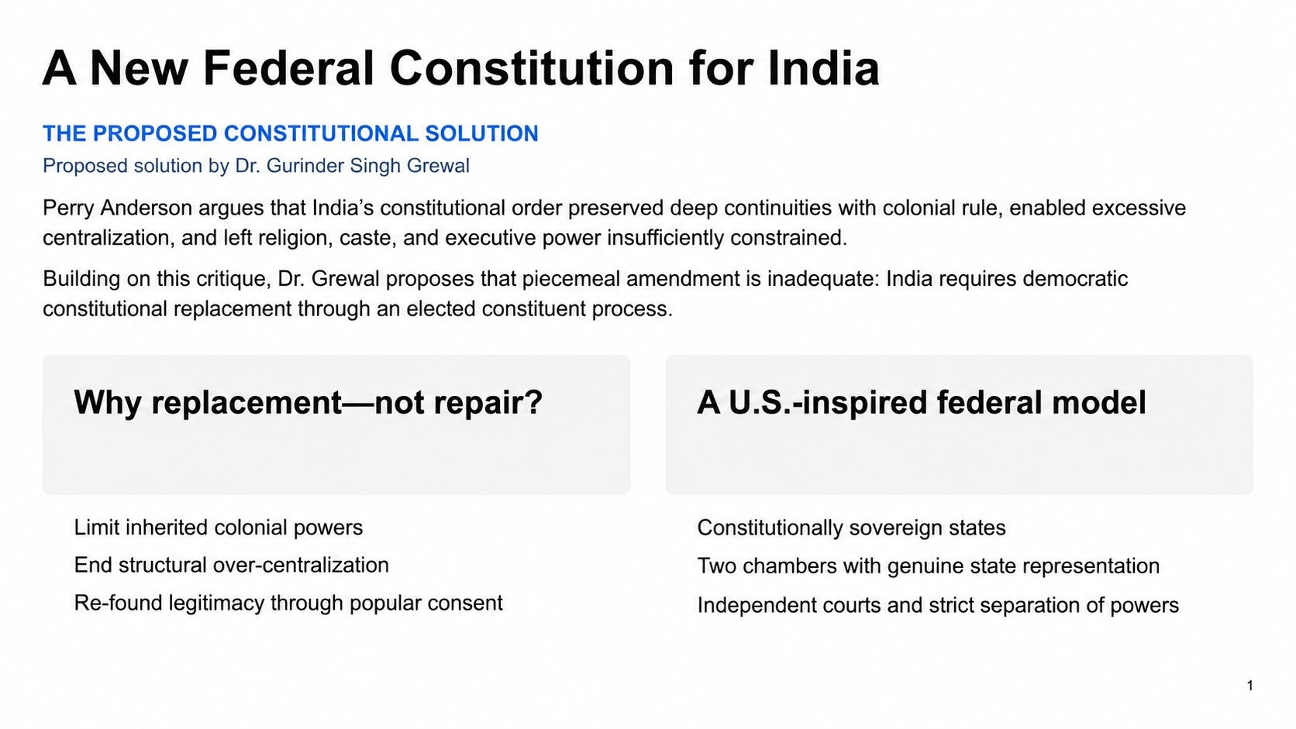

Slide 21
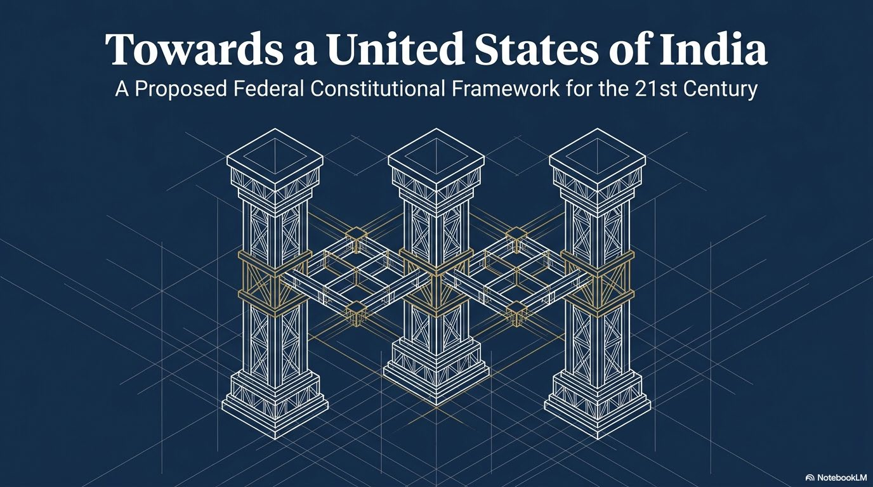

Slide 22
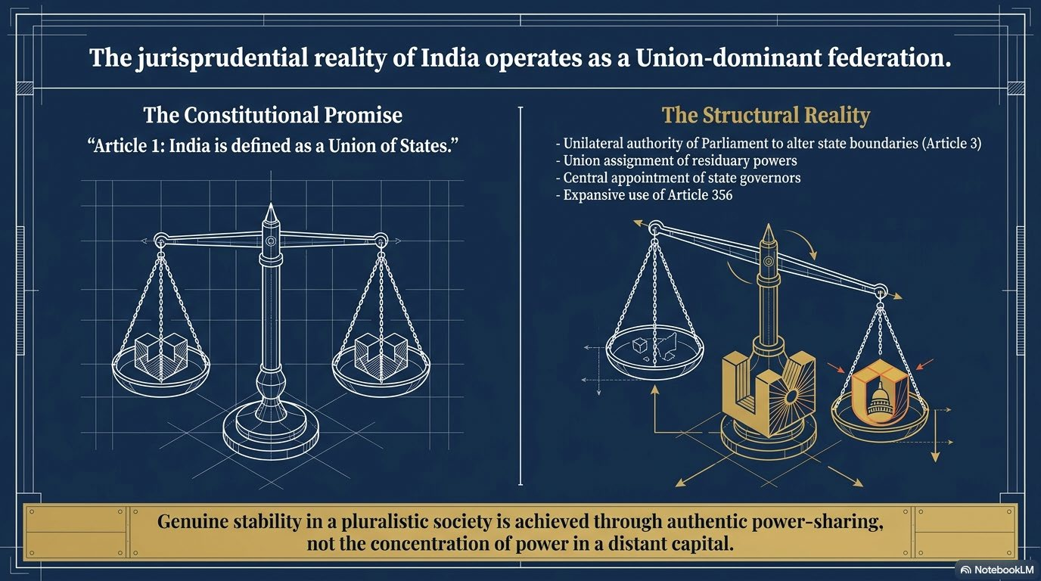

Slide 23
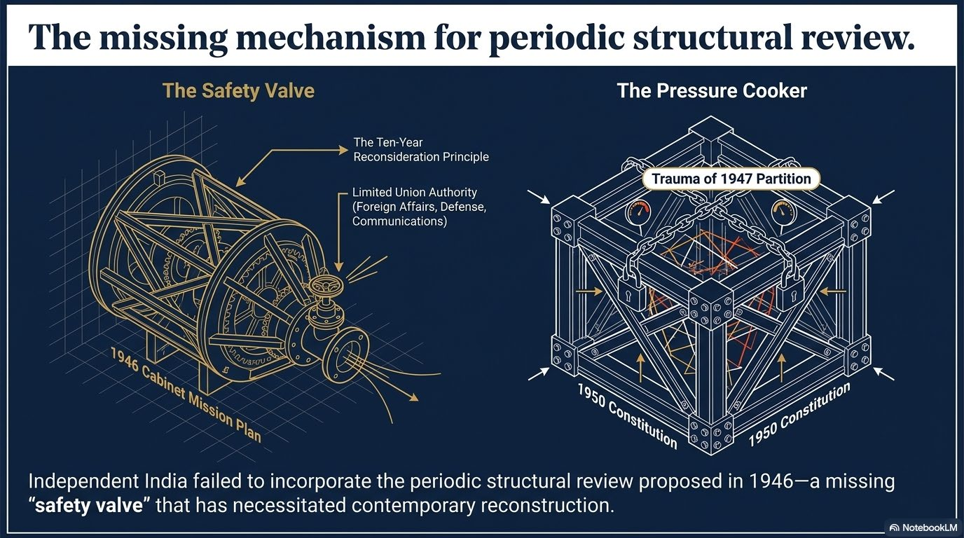

Slide 24


Slide 25
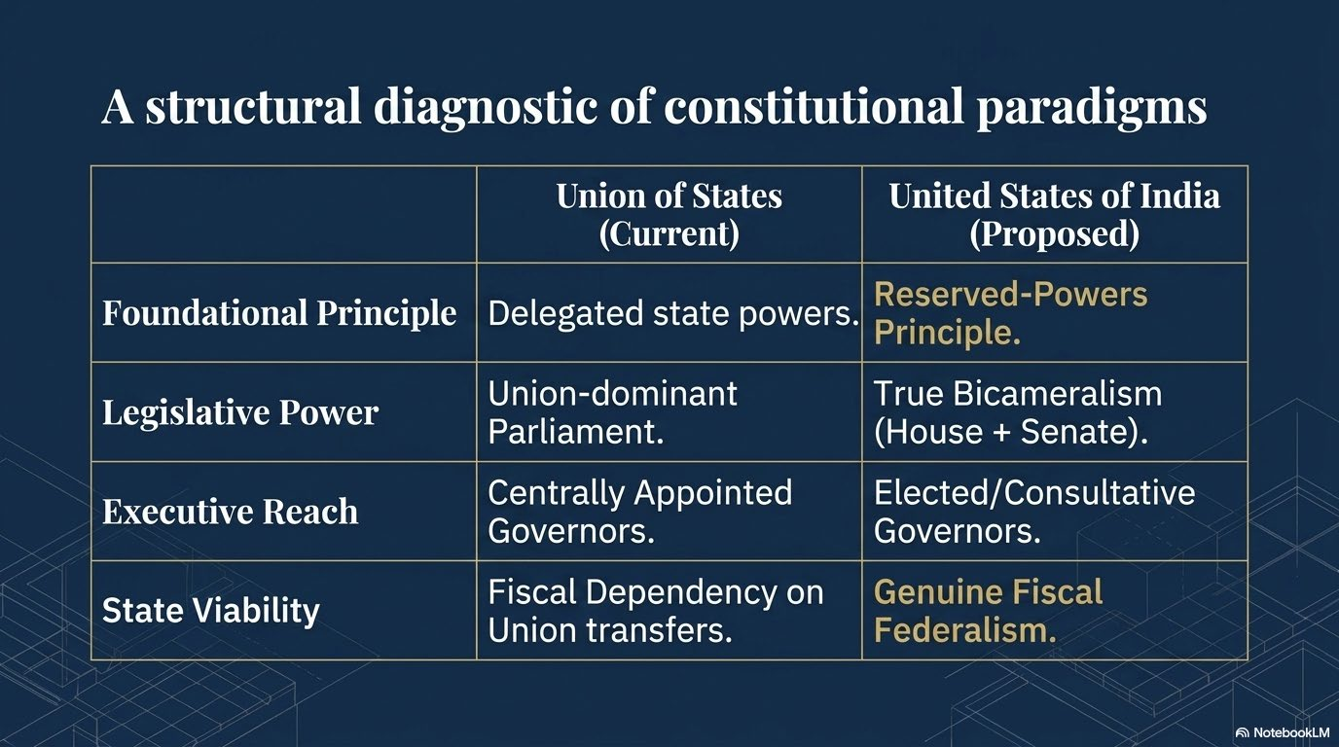

Slide 26
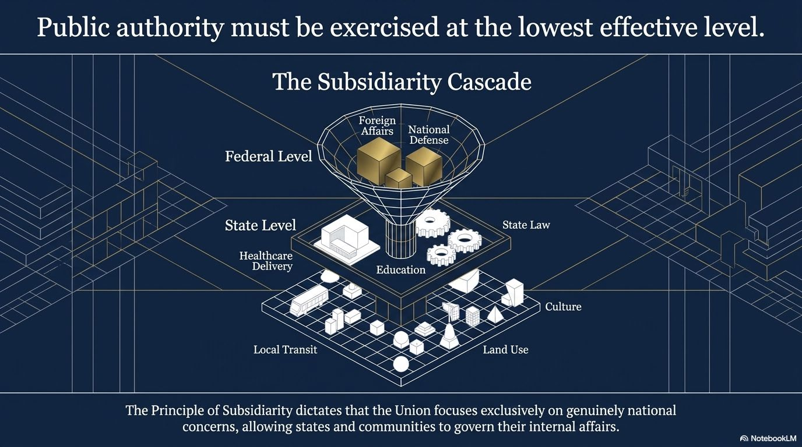

Slide 27


Slide 28
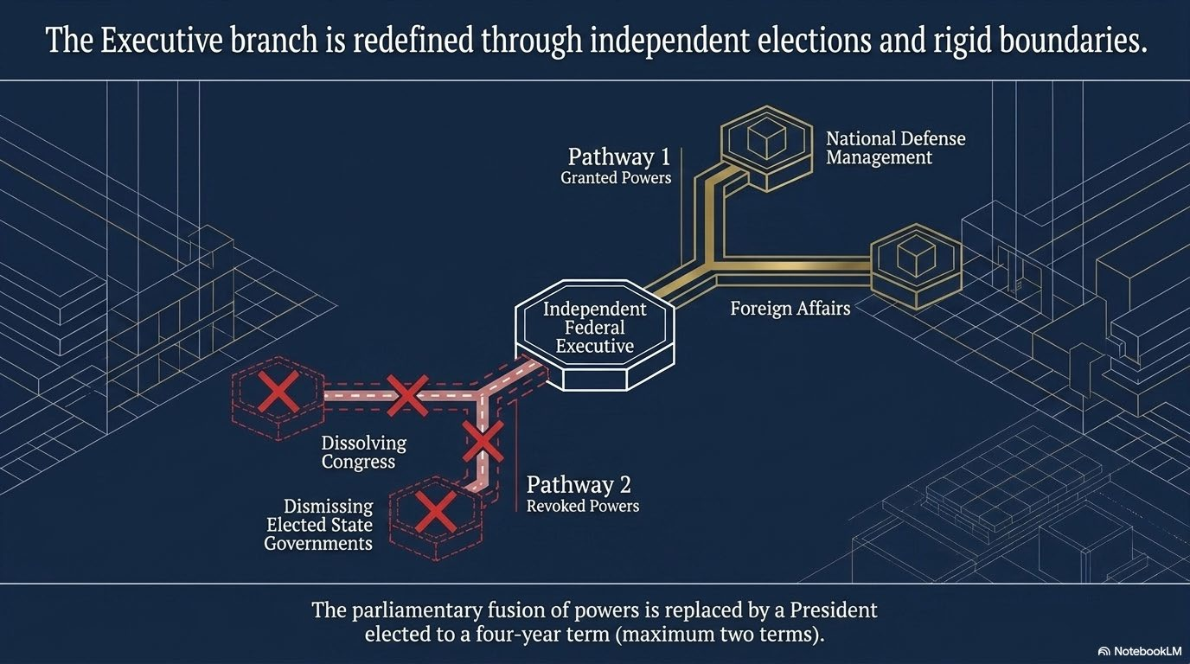

Slide 29
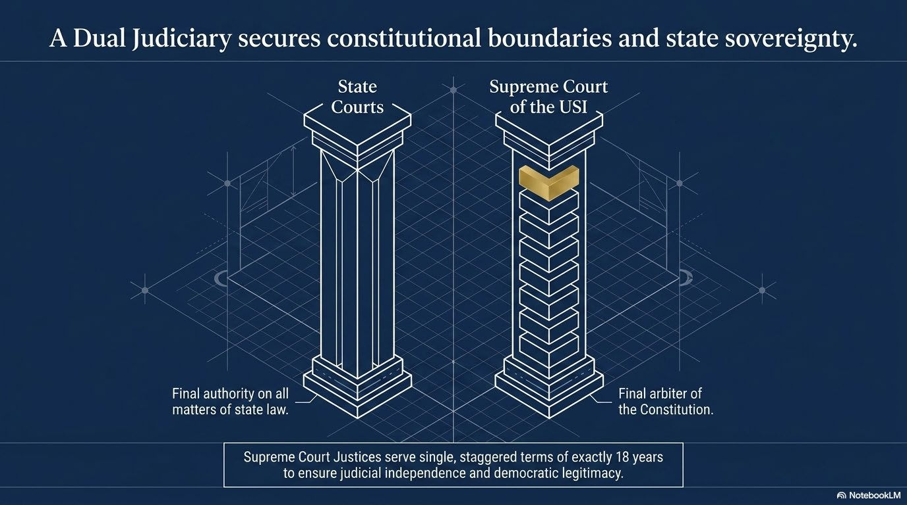

Slide 30
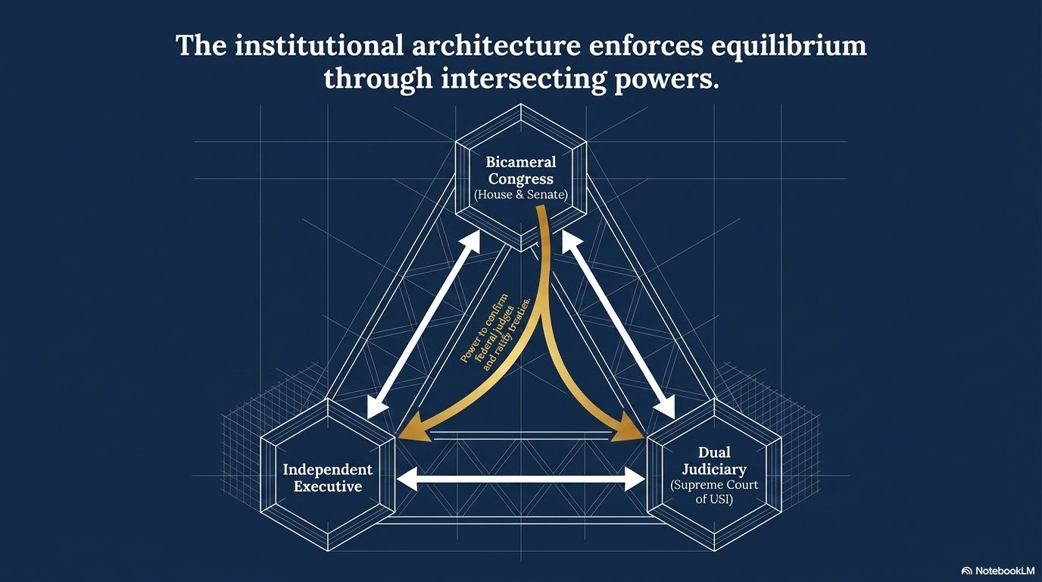

Slide 31
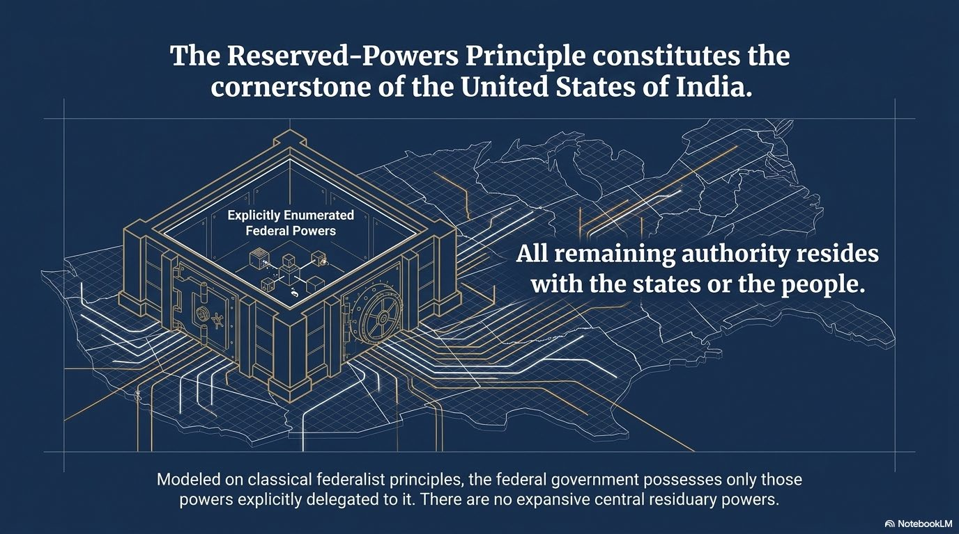

Slide 32
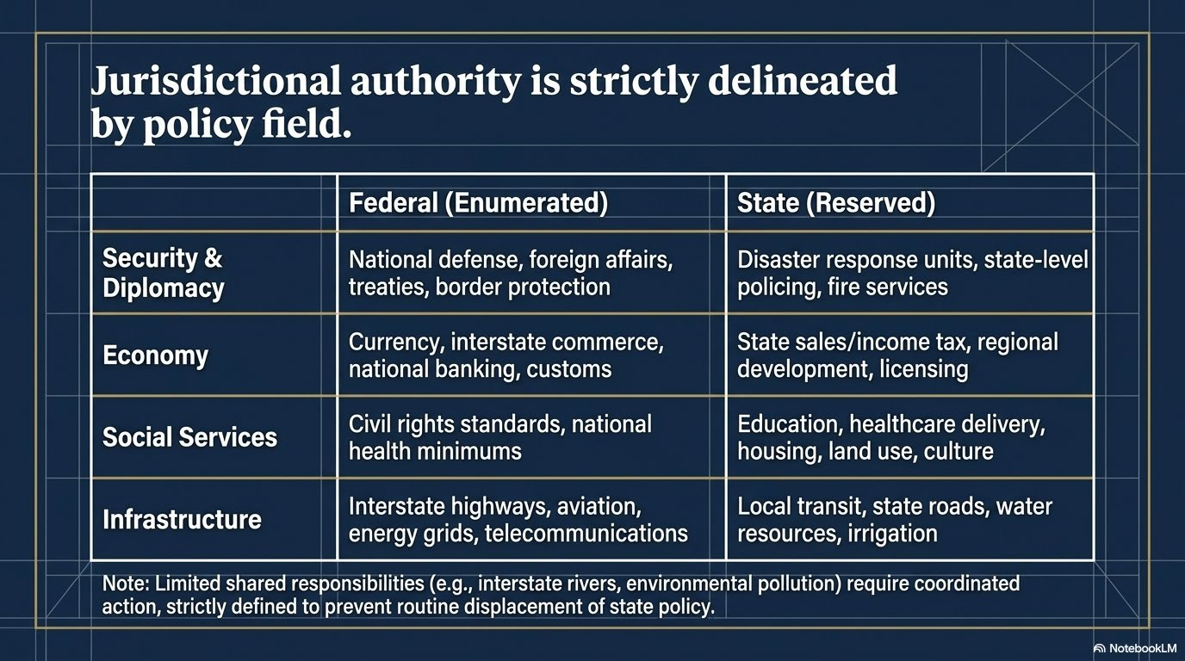

Slide 33
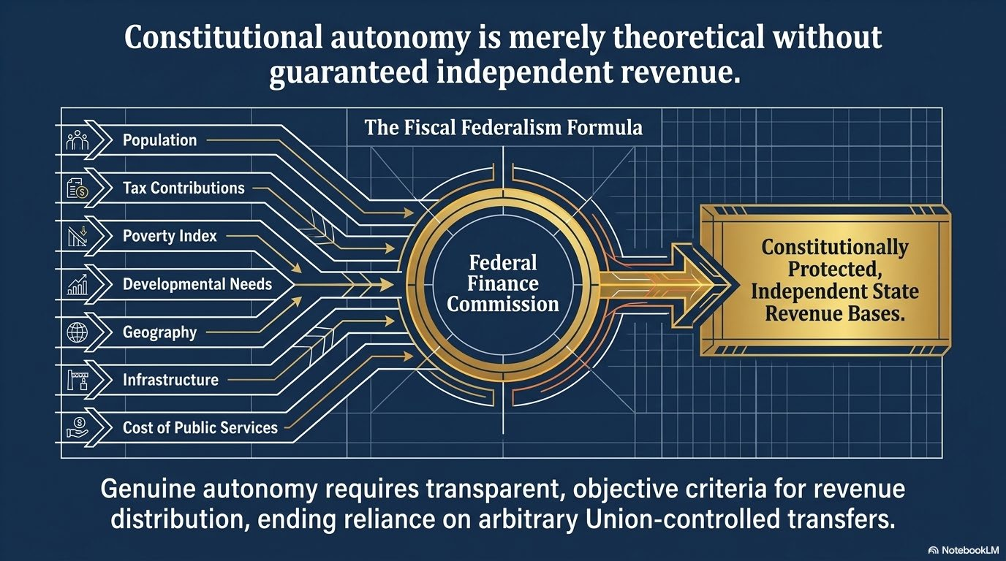

Slide 34


Slide 35
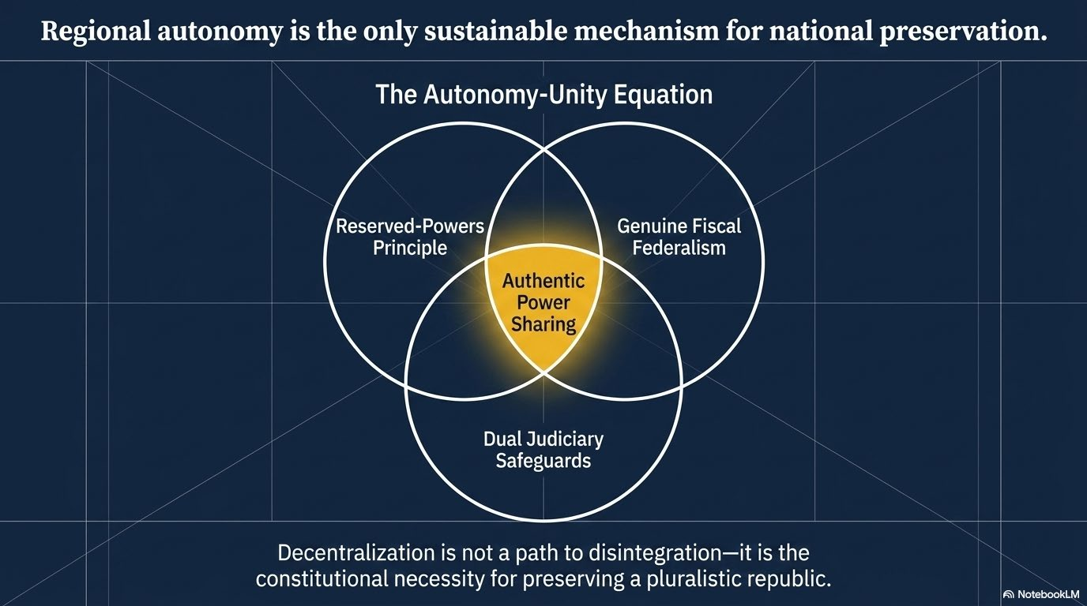

Slide 36
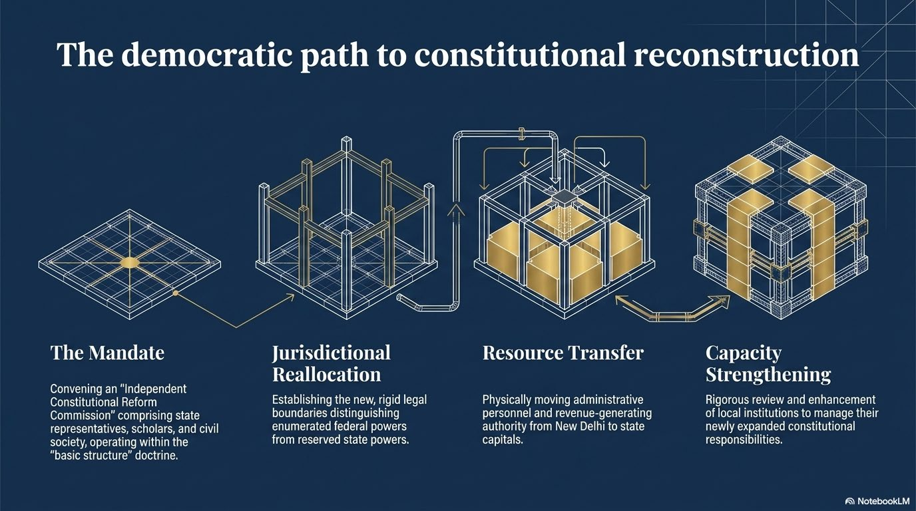

Slide 37
