Slide 1
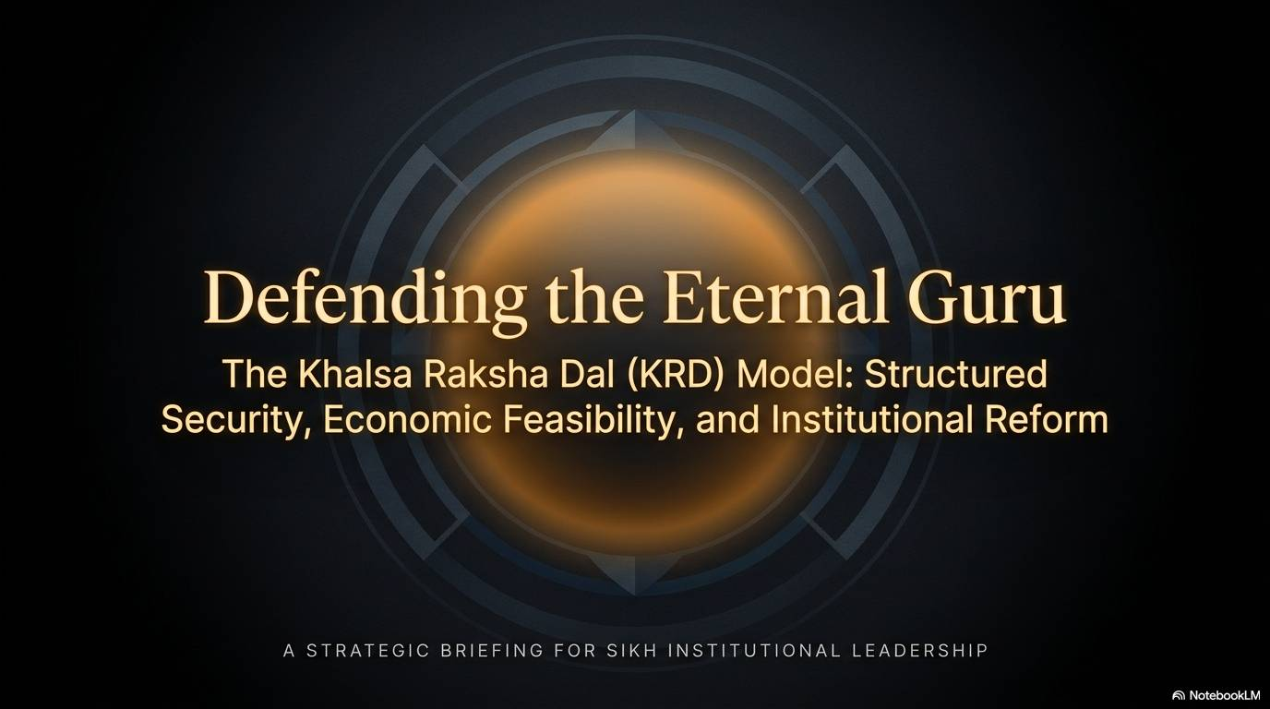

Slide 2


Slide 3
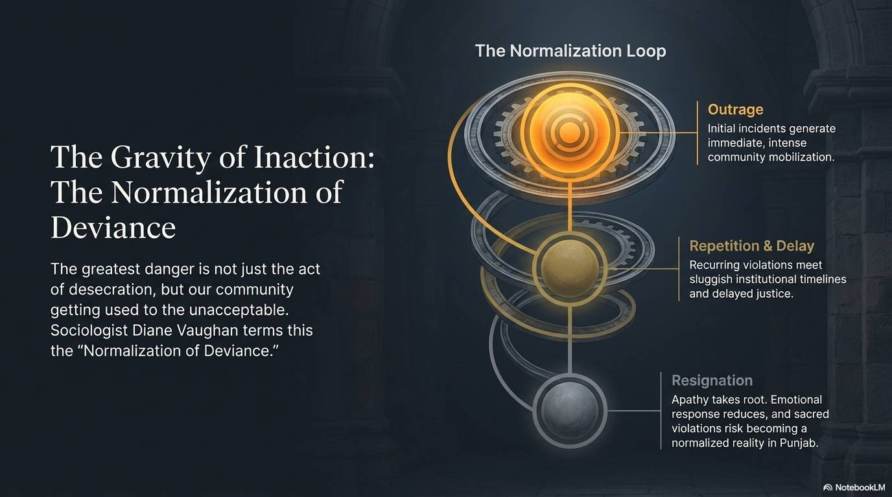

Slide 4
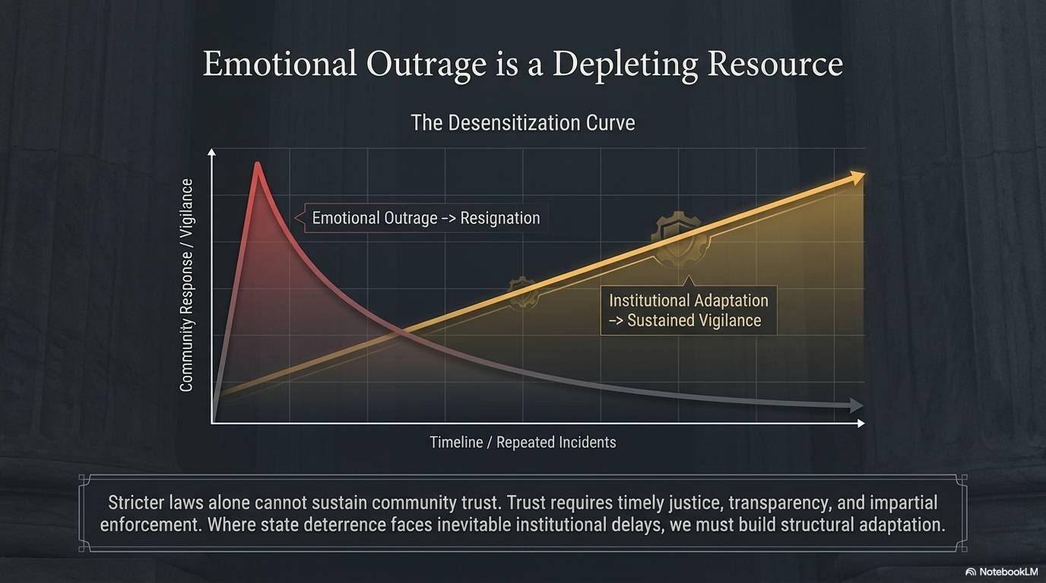

Slide 5
Title: What is Psychological Desensitization?
Content:
“Repeated exposure to traumatic or distressing stimuli can lead to psychological desensitization, whereby emotional responses are diminished, and previously abnormal conditions begin to be perceived as normal.”
Key Points:
Reduced emotional sensitivity over time
Brain adapts to repeated stress
Protective psychological mechanism

Slide 6
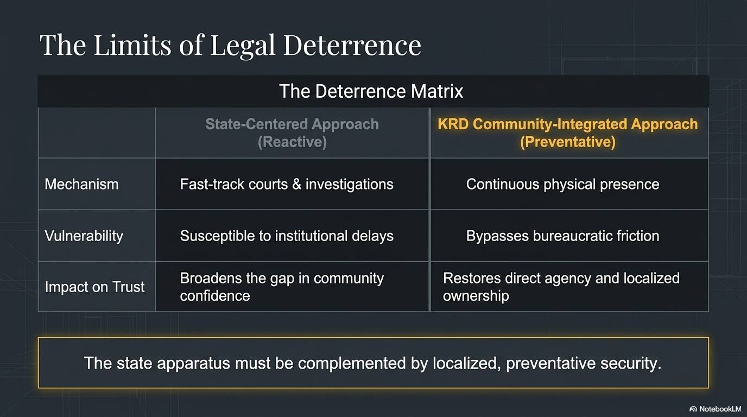

Slide 7
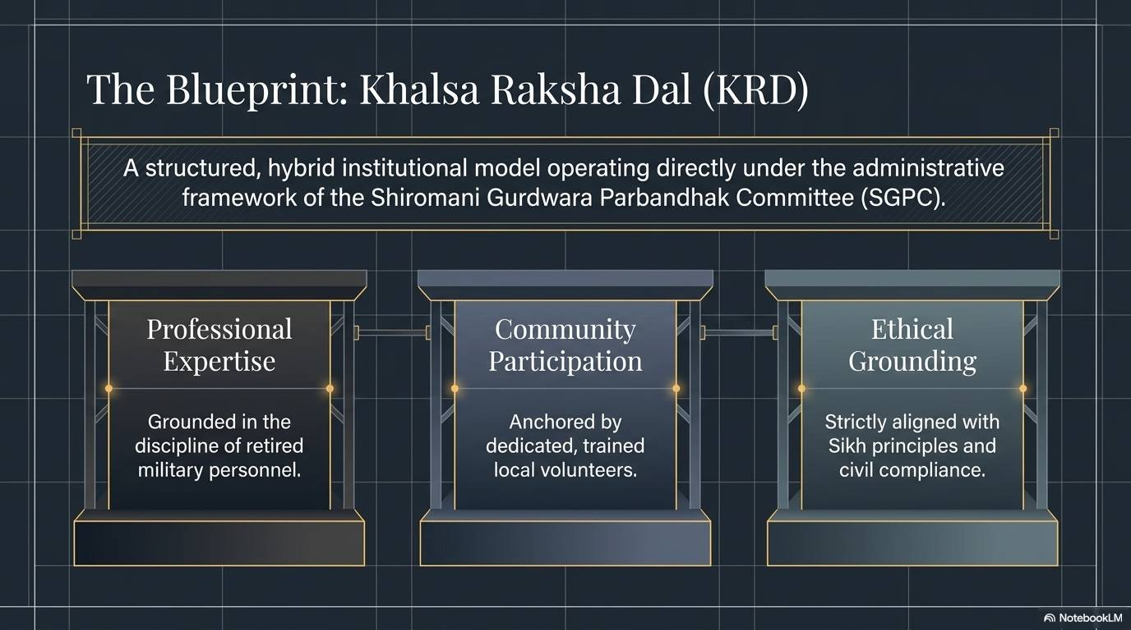

Slide 8


Slide 9


Slide 10


Slide 11


Slide 12
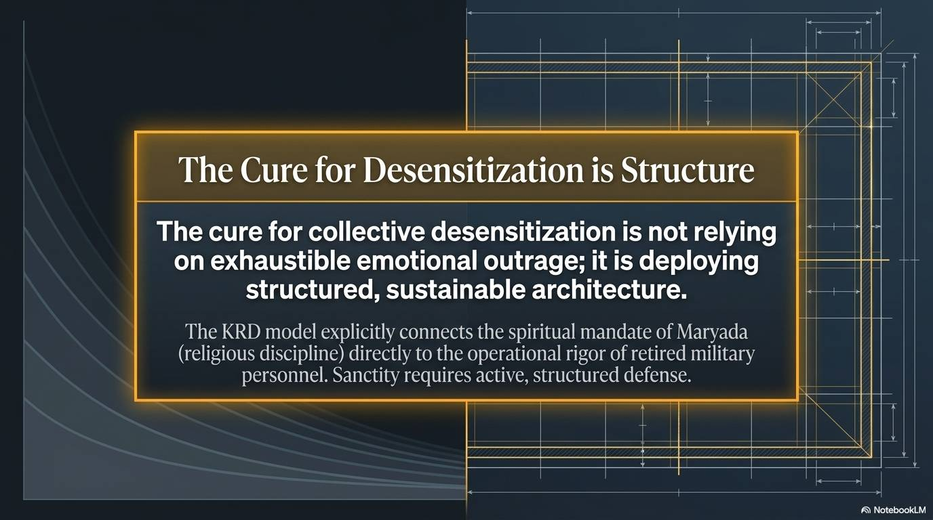

Slide 13
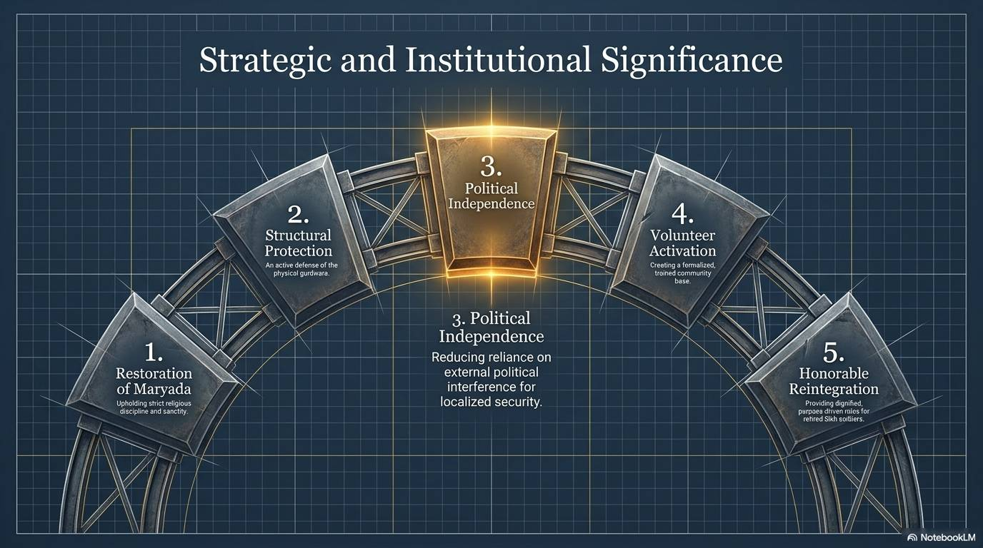

Slide 14
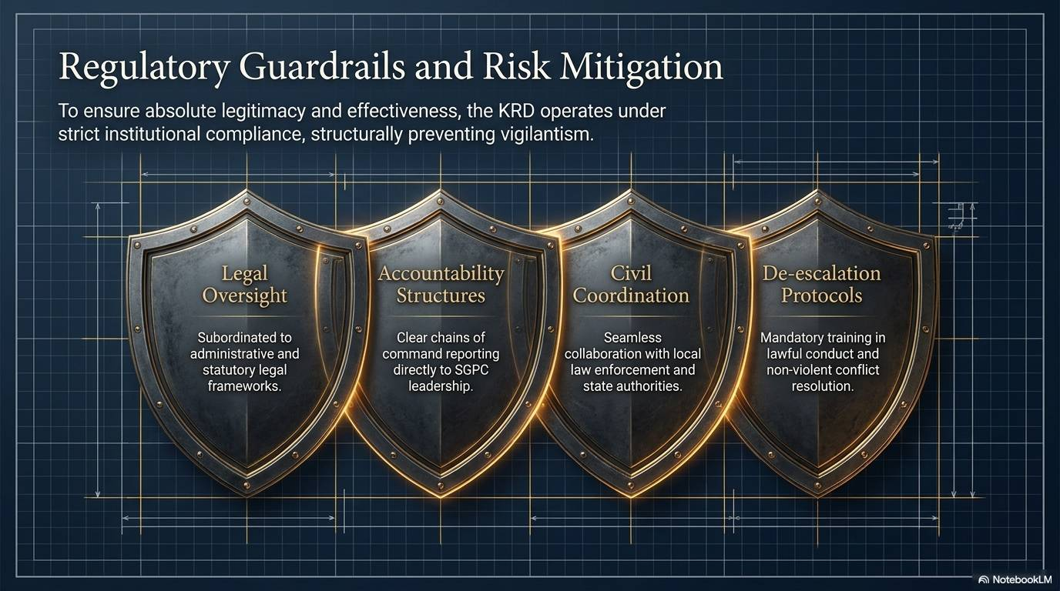

Slide 15
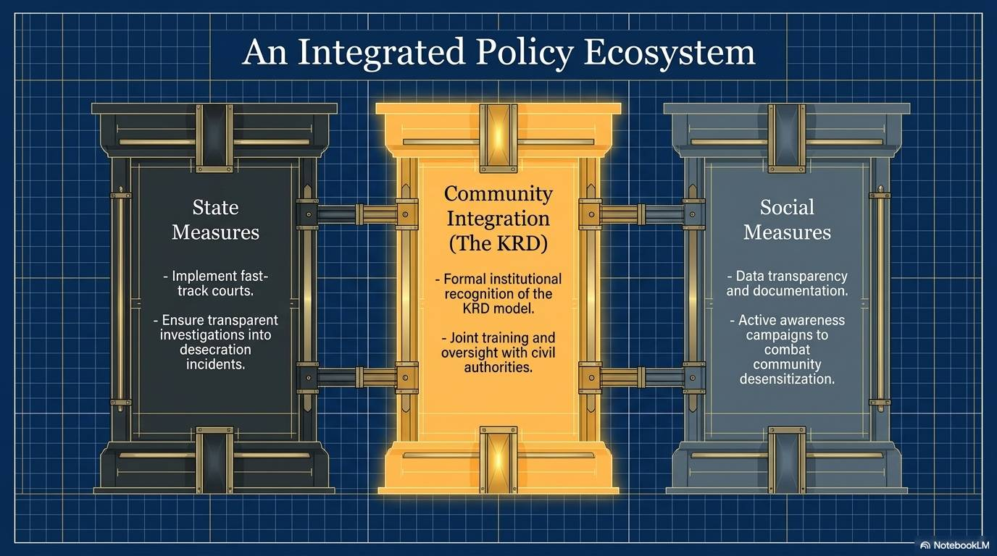

Slide 16
