Slide 1
Rebuttal to Sukhi Chahal
By: Gurinder Singh Grewal

Slide 2
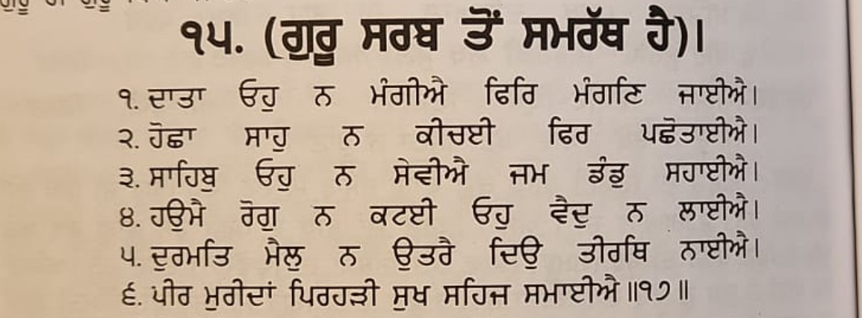
Mr. Chahal says BJP/RSS has all the power. The Sikh’s should cooperate or join RSS to get the benefits.
Response: Mr. Chahal is totally ignorant of Sikh principals and Sikh correctors. Two younger sons (Sahibzada) of Guru Gobind Singh. Fateh Singh (7 years old) and Jorawar Singh (9 years old) gave their lives but did not accept all the offers of Sirhand ruler. These RSS Sikh’s are celebrating Bal Diwas but do not understand the meaning of their sacrifice.
Bhai Gurdas

Slide 3
Mr. Chahal brags that he stays in CM Yogi’s house as a guest and has access to Home Minister and Prime Minister of India.
Response: Mr. Chahal does not know Sikh history. Guru Nanak while traveling preferred to stay in the house of Bhai Lalo (a poor carpenter) and refused to eat at the house of Malak Bhago (a wealthy merchant of his time).

Slide 4
Mr. Chahal is asking the Sikh community to support Mr. Modi to get his help.
Response: Mr. Chahal needs to remember that during Indra Gandhi’s emergency, Mr. Modi survived by disguising himself as a Sikh and taking shelter in Gurdwaras.

Slide 5
Mr. Chahal brags that RSS is good for the Sikh community.
Response: Let us review RSS’s contributions
1953 Mr. Mukerji, the first president of BJP accompanied by Mr. Bajpai went to Kashmir to protest against the special privileges given to Kashmir; however, at the Kashmir border he left Bajpai in Punjab to appose Sikh majority state/Punjabi Suba. B.D. Pande, the governor of Punjab, in his book has confirmed the poisiones role of RSS sponsored Jullundar newspapers.
Sikh’s were demanding to remove the cigarette and liquid shops in the vicinity of Golden Temple. BJP/RSS paraded with 10,000 followers around the Golden Temple with cigarettes/Bidis in their hands chanting “cigarette Bidis Peenge, Shan se jeenge”.

Slide 6
Harbans Lal Khana on February 14, 1984 destroyed a model of Golden Temple publicly near railroad station, Amritsar. This shows BJP contempt for Golden Temple.
Prior to Blue Star in 1984, Mr. Lal Krishan Advani led a demonstration demanding that Indra Gandhi should send an army to invade Golden Temple. A picture showing this is in his book titled My Life My Country.
After Blue Star BJP/RSS workers distributed sweets in the streets.
Nana Ji Dhesh Mukh (RSS leader) wrote an article “Moment of Soul Searching”. In this article not only did he praise Indra Gandhi for Operation Blue Star, but he also blamed the Sikh leadership for daily Sikh Carnage/ Genocide.

Slide 7
In 1991 during BJP rule, 10 Sikh’s in Pilibhit were killed; however, no action was taken by the Government.
Modi as a Chief Minister, passed a law in Gujrat taking back the land from the Sikh people in Kach area; however, lost in the high court. After that, BJP workers started harassing the Sikhs’.
During Modi’s rule, Sikhs’ who were settled in Assam, were being uprooted.
During farmers agitation, a Minister’s (Mishra) son ran over the Sikh people in his Jeep and killed several. He was then released without any punishment.
Mr. Modi has been bragging that we will kill (Guskek Marange). He is personally responsible for the killing of Sikh leaders in Lahore, London and Surrey Canada and for authorizing the assassination of Gurpatwant Singh Pannu.

Slide 8
List of Gurdwaras Demolished by the RSS/BJP
Mechuka in Arunachal Pradesh
Gyan Godri in Hardwar
Nanakbari in Hardwar
Gurdwara Nanak Bari near Reetha Sahib in Uttarakhand
Gurdwara Nanak Padao near Reetha Sahib
Gurdwara Almora in Uttarakhand
Gurdwara Paua Sahib
Gwalior related to Guru Gargobind Sahib
Gurdwara Manji Sahib Kalsi Uttarakhand, related to
Guru Gobind Singhji
Gurdwara Smadh Rani Jind Kaur at Ram Kund Nasik, Maharashtra

Slide 9
Sukhi Chahal (RSS Sikh) is only a low-level agent for the Indian government and their San Francisco consulate. He is using his connections to get Visa for someone or passport renewal etc. beyond that he has no power.
If he truly has any power, he should:
Get article 25 reappealed
Get Chandigarh to Punjab
Get Bhakhra Dam back to Punjab
Free Punjab University from the Center
Free Bandi Singhs’ who already have served their sentence
This list can be very long

Slide 10
Truly speaking there is no democracy in Punjab/India
Governor of Punjab is not elected by the people of Punjab
Prime Minister Modi has not won any election in Punjab
President of India has not been directly elected by the people of Punjab
Now they have sent an RSS agent disguised as a Sikh to deceive and exploit the Sikh Diaspora
We, the Sikh in the USA will not allow this to continue

