Slide 1
Sikh Genocide in the 18th century
The Small Holocaust of 1746
(Chhota Ghallughara)
The Large Holocaust of 1762
(Vadda Ghallughara)

Slide 2
What is Genocide?
A well-planned targeted killing of ethnic, racial, or religious groups, elaborated by Raphael Lamkin in 1944.
Norman Naimark in his book, Genocide: A World History, defines, “Over the ages, genocide has had both external and internal dimensions. Political leaders have turned against internal groups-tribal, ethnic, religious, social – and sought their elimination as a way to preserve privilege, avoid dissidence, consolidate power, and accumulate wealth. They also have conquered and dominated neighboring or (distant) territories for imperial purposes and have killed and suppressed, as well as co-opted native people of those regions in order to dominate them and seize their land and resources.”

Slide 3
Ten Stages of Genocide by Prof. Gregory Stanton
1. Classification: First a perceived threat is defined some kind of evil that requires exclusion
2. Symbolization: Symbols of infernal hatred to be associated with the targeted group
3. Discrimination: The use of discriminatory laws to deny their civil rights
4. Dehumanization: The dehumanization must become a normal and widespread routine.
5. Organization: The criminal syndicates and vigilantes are trained and provided lethal resources to perpetuate exclusion, discrimination and dehumanization.

Slide 4
Ten Stages of Genocide by Prof. Gregory Stanton
6. Polarization: The polarization takes place through agent provocateurs, politicians in power, media and specially recruited writers.
7. Preparation: A policy is designed to legalize killing, torturing, raping and looting by the mainstream society.
8. Prosecution: A death list is drawn of the dehumanized ethnic, racial or religious group
9. Extermination: It creates circumstances for the targeted group to assemble in a large number massacre them with the maximum traumatic effect to the survivors.
10. Denial: The process of extermination and denial go hand in hand.

Slide 5
Ghallughara or Genocide ?
Ghallughara is a compound two Punjabi words, “Ghall” means total annihilation, and “Ghara” means a high tide of violent force that leaves a trail of death and destruction. In other words, it means deadly visible impact on the people and places it visits.
A targeted ethnic, racial or religious group helplessly huddle for Safety and Security and then exterminated with intense violent force.
Ref: Bhai Kahan Singh, Mahan Kosh

Slide 6
Genocide of 1746, a Brief Outline
The Small Holocaust, 1746,
or Chhota Ghallughara, 1746
Actors: Mughal Emperor, Punjab Governor Yahiya Khan and his Upper Caste Hindu Chief Lakhpat Rai and Faujdar Jaspat Rai
Allies: Hindu Hill Chiefs (Rajas) a major factor in shaping Mughal’s policy towards Sikhs
Vigilantes: Under the leadership of Feudal Leaders and Elites belonging to both Islam and Hinduism
Targeted Groups: Ethnic Sikhs labeled as career criminals, low caste untouchables, poisonous snakes, outlawed and dispossessed of their properties.
Targeted Places: Golden Temple, Guru Granth Sahib, and Gurdwaras, Sikhs’ properties
7000 children, women and old men killed by laying a siege and more than 3000 executed in the capital city.

Slide 7
Why? Sectarian Knowledge is a social construct for Greed and Power that denies access to human potential especially for the lowest of the lows.
Name: - ------------
NAAM : Neutral Secular, non- specific
Specific: Allah, Lord, God, Ram, Rahim, Krishan, Waheguru, Issa, Hari, Swami, Kartar, Parmatma
As there are thousands of languages, so there maybe thousand different names for the NAAM
“Those who have forgotten Naam are caught in duality. They putrefy and die and are consumed by the fire of desire.” SGGS 19
“When you meet a True Guru, you can discover Naam. One recognizes a True Guru meeting whom you discover Naam.” SGGS P. 72

Slide 8
The Birth of Stereotypical, Dehumanizing Hatred for Sikhs in 1605-1704 (Classification)
In 1605 Mughal Emperor Jahangir ordered the execution of the 5th Guru, Guru Arjan
Why?: The Religion is drawing “Simple Hearted Hindus” and “Even Foolish and Stupid Muslims” Jahangir’s reference is to Shudras’ (Untouchables) hierarchical position both in Hinduism and Islam.
Action: Emperor’s Edict “I ordered that Guru Arjan should be put to death by tortures.’ (Discrimination and Dehumanization)
Reference: Captivating the Simple – Hearted, A Struggle for Human Dignity
By Pieter Frierich and Bhajan Singh

Slide 9
Mughal Royals and Hindu Bureaucrats Shape Ultra-Nationalistic Policies against Followers of Nanak (Organization and Preparation)
Agency: High Ranked Mughal Hindu Official Chandu carried out the execution with severe tortures mostly described in Manu Samriti, a Hindu law against Untouchables

Slide 10
Boiling in a Cauldron and Pouring Hot Sand

Slide 11
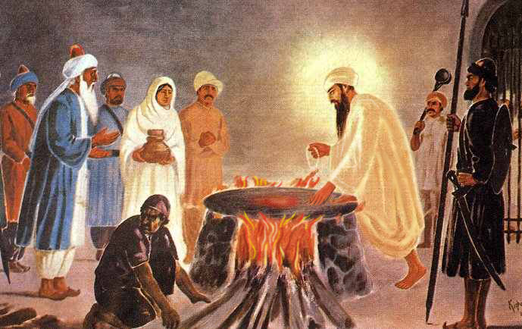
Images of Guru Arjan’s Tortures
Made to sit on a Burning Hot Iron Plate

Slide 12
Ideological bases of Hatred Determine Polarization and Persecution
In 1675: Guru Teg Bahadur and his three followers executed for standing up for the Sikh beliefs
In 1704 10th Guru’s sons(aged 5 and 7) bricked alive and several thousand killed by tortures

Slide 13
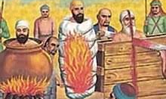
Persecution of Guru Teg Bahadur and His Sikhs, Mati Das, Sati Das, Dyala

Slide 14
Four Massive Mughals’ army attacks on 6th Guru, Thirteen on the 10th Guru: Discrimination 1634-1708
The gigantic Mughal army infrastructure and Hindu Chiefs carry out organized attacks on Sikhs with a view to silence and dehumanize them forever.
1707-1712 Mughal Emperor Bahadur Shah and Farrukh Siyar reiterated the policy of Sikhs extermination
“The Mughal Emperor released a Royal Edict on December 10, 1710, “Kill the disciples of Nanak (the Sikhs) where they were found.” Ref. Ganda Singh
” Historian writes, Emperor Farrukh Siyar on March 5, 1716, repeated general massacre of Sikhs – men, women, and children.”

Slide 15
Persecution of Banda Singh Bahudar, a Sikh commander 1710-1716
His eyes were gouged, his hands and feet were chopped, his body torn apart with red hot pincers, his infant son was hacked into pieces, and his quivering heart was thrust in his mouth.
His 793 followers were tortured in the similar manner to make it a spectacle for the public
Death lists were made to execute Sikhs everywhere. 20,000 -25,000 civilian Sikhs lost their lives due to the vigilante violence.

Slide 16
Public Execution of Sikhs in 1716

Slide 17
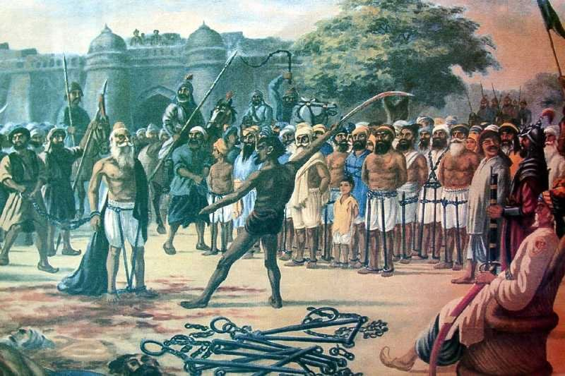

Slide 18
Punjab Governors Abdul Samad Khan and his son Zakriya Khan, 1716 -1745
Abdul Samad Khan 1716-1726 : He reshaped the persecution policy to make it more stringent.
Rewards were announced for cutting Sikh hair, detaining, seizing their land and property, beheading by tortures. This was dehumanizing, organizing, polarizing and preparation for protracted persecution.
Lakhpat Rai and Jaspat Rai were notorious for recruiting Feudal lords and elites to rouse mobs against Sikhs.
Notable among them was Chaudhary Karma of village Chhina, Rama Randhawa of Talwandi and Massa Ranghar of Mandiali

Slide 19
Sikhs’ Head hunting A Profitable Business
Historian Khushwant Singh says,
“Zakriya Khan had made head hunting a profitable business by offering rewards, a blanket for cutting of a Sikh’s hair, ten rupees for the whereabouts of a Sikh, fifty rupees for a Sikhs’ scalp. Giving shelter to Sikhs and withholding information of their movements was made a capital offense.”

Slide 20
Bhai Mani Singh, A Sikh Scholar’s Execution
Bhai Mani Singh diffused the Mass Massacre plan of Diwan Lakhpat Rai and Zakariya Khan in 1738
Sikhs were offered free access to Golden Temple. About 10,000 were expected to attend the Bandi Chhor Diwas (Diwali)
Mughals and Hill Chiefs under the Command of Lakhpat Rai were tasked to lay a siege and exterminate all of them
Bhai Mani arrested and tortured in the most inhuman and barbaric way.

Slide 21
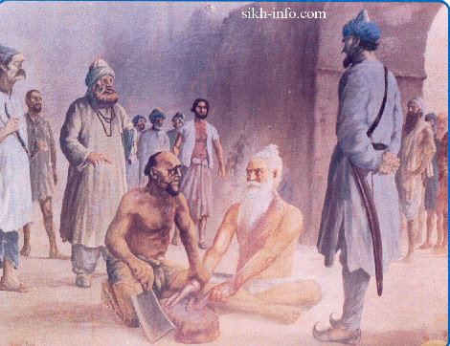
Bhai Mani Singh Chopped Limb by Limb
Bhai Mani Singh Chopped Limb by Limb

Slide 22
Sabeg Singh and his son Shahbaz Singh
Sabeg Singh and His Son Shabaz Singh

Slide 23
Taru Singh Accused of “Langar for the Needy”
Taru Singh “Langar for the Needy”
Historian Cunnigham says, “He would neither yield his conscience nor the symbol of his conviction”

Slide 24
Mughals’ Hitman Massa Ranghar 1740
He Desecrated Golden Temple, Filled the Sacred pool with Carcasses of Cows, Brought Women Dancers, and Held Sikh Women Captives for his pleasure
Two Sikhs in 1740 disguised as Mughals, Mehtab Singh, and Sukha Singh from Jaipur entered the Darbar Sahib, Sukha guarded the entrance and Mehtab Singh with a single stroke of his sword cut Ranghar’s head off and escaped taking it as a trophy.

Slide 25
All Lahore’s Sikhs Executed at Horse Market (Survivors Relocate for Safety)
On March 10, 1746, the entire city of Lahore emptied of Sikhs and executed publicly.
Public warned not to utter anything like “Guru, or Gur” and urged to destroy Guru Granth Sahib if found anywhere. The Holy Tank Amritsar again filled with blood and gore.
Diwan Lakhpat Rai now launched second phase of his bloody campaign. He invited all Anti-Sikh citizens to join in the State’s effort to ferret out Sikhs from their hideouts in forests and kill them

Slide 26
Shaheed Ganj 1735-1746
20,000 -25, 000 Sikhs were executed and rewards distributed.
The City of Lahore had not a single family of Sikhs in its periphery.
Sikhs could be killed anywhere by anyone; therefore, the survivors had no choice except to escape to the inhospitable forests.
Massa Ranghar, a vigilante became rich with blood money as he would bring several thousand Sikhs’ heads and would bring prisoners for their execution. Then he desecrated Harmandir Sahib by filling the sacred pool with corpses of Sikhs and cows. He held drinking parties and had prostitutes to reward the killing of Sikhs.
Notable among those killed: Bhai Taru Singh, Bhai Sabeg Singh and Bhai Shabaz Singh. Bhai Mani Singh, the close associate of Guru Gobind Singh,

Slide 27
The Execution Site in Lahore Gurdwara Shaheed Ganj Singhinian

Slide 28
Mughal Faujdar Jaspat Rai and Sikhs 1745 -46
Zakriya Khan’s death gave some break to Sikhs’ persecution as power struggle between two brothers distracted them.
On Yahiya Khan’s installation to the Governorship of Punjab, Diwan Lakhpat Rai promised his boss to escalate killing of Sikhs and their conversion to Islam.
In the meanwhile, he was shocked to know that his brother Faujdar Jaspat Rai of Eminabad got killed in his attempt to chase and kill Sikhs. A Rangretta Sikh in a snap climbed up the elephant Jaspat Rai was riding and beheaded him in flash of seconds.
The death of his brother by a former untouchable, the lowest of the lows in the caste hierarchy , gave him an opportunity to rouse religious sentiments of Hindus and invoke extreme tortures described by ancient texts by Chankiya and Manu against untouchables, now all Sikhs condemned as such.

Slide 29
May 1746, Ghallughara/Genocide
Mughal army and huge crowds of excited vigilantes march to the Kahnuwan forest.
They use all means such as cutting trees, setting fire, letting hound dogs after old men, women, and children.
About 7000-10,000 are instantly killed, 3000-4000 are taken as prisoners, later to be executed publicly at Horse Market, Lahore.
It was a great loss for a tiny Sikh community hardly 1 million among 40 millions of Muslims, Hindus and others. 40-50 percent population was exterminated.

Slide 30
Diwan Lakhpat Rai Destroys Guru Granth Sahib Birs and Discards them in Rivers and Wells and Burnt Many other Historical Manuscripts
“Cultural genocide, or ethnocide, is the attempted destruction of a group's culture, religion, and identity. It is a coercive act imposed by a dominant group upon a weaker or minority group. It is particularly associated with forced religious conversion and with forced assimilation policies, including child removal and the outlawing of cultural expression.”
Treglia, G. (2016). Cultural genocide. In J. Mackenzie (Ed.), The encyclopedia of empire. Hoboken, NJ: Wiley.

Slide 31
The End of Mughal Empire in Greater Punjab Sikhs Built the Fort Ram Rauni
The First Afghan invasion March 1748
The Stage Set for Afghan Emperor Ahmed Shah Abdali to occupy Punjab breaking it away from the Mughal Empire altogether
The RamRauni Fort Built in 1748
To Break the Cycle of Tortures

Slide 32
Sikh Women Captive at Mir Mannu’s Death Camp

Slide 33
Punjab Annexed to Afghanistan Empire
Ten Invasions of Emperor Ahmad Shah Abdali on India
1748 Mir Mannu Installed Governor of Punjab and declared victory against Abdali
1750 Mughals Concede Punjab Territories to Afghan Abdali
1751-1752 : Punjab Annexed to Afghanistan
1756-1757 India’s Capital Under Afghans
1759-1761 Third Battle of Panipat. Marattha’s Historical Defeat
1762: Wadda Ghallughara
1764-1765: Sikhs Liberate Punjab
1766 The Sikh Missal Rule, Failed attempts of Abdali
1768-1769: Abdali again fails to subdue Sikhs

Slide 34
Genocide of 1762, or (Vadda Ghallughara, 1762) a Brief Outline
February 1762 at Rohira-Kup
Actors: 1. Afghan Ruler Ahmad Shah Abdali
2. Governor of Sirhind, Jahan Khan
3. Governor of Malerkotla, Hinghan Khan
4. Hindu Hill Chiefs
Allies: Niranjanias or Hindalis of Jandiala under the patronage of both Mughals, Afghans, and Hill Chiefs; Key Spy Center against Sikhs.
Vigilantes: Organized and trained Bands of Hate Groups guided by Elites (Chaudharis)
Ghara (The Genocidal Effect):
About 30,000 – 35000 Sikhs Massacred. Sikhs’ Most Sacred Place Harmandir Sahib (Golden Temple) blown up with Gunpowder.
Sikhs’ Guru Granth Sahib, scriptures and other artifacts destroyed.

Slide 35
30,000-35,000 Civilians Massacred February 5, 1762 (Extermination)

Slide 36
Why Vadda Ghallughara? A Context of 1759-1761
When Abdali after his victory passing through Punjab: Several Cart-loads of looted wealth and 2200 Young Hindu Women prisoners, Sikhs’ Raids deprived him of lot of wealth, and Women were freed from the captivity.
Sikhs honorably restored the young women to their families and won admiration for their acts, and condemnation of Hill Chiefs and many Hindu Bureaucrats who were considered a party to their enslavement.
The only hurdle in his way to become the Emperor of Hindustan were the Sikhs. Abdali resolved to teach Sikhs a lesson.

Slide 37
Ahmad Shah Abdali Builds a Coalition to Punish Sikhs
Governor of Sirhind: Nawab Jahan Khan: Command Centers
Governor of Malerkotla: Hinghan Khan: Command Centers
Hill Chiefs: to lay the siege
Patiala Sikh Chief Baba Ala Singh, to Promise Safe Shelter to families
Niranjania or Hindali Sect of Jandiala: Aquil Das to act as Sikhs’ friend, and then Invite Abdali
Jalandhar Doab Afghan Governor: Raja Ghumand Chand of Katauch
Nawab Malerkotla was tasked to trap Sikhs by baiting them

Slide 38
Niranjanias or Hindalis, A Breakaway Sect known for Disinformation against Sikhs
Anti Sikh Forces Employed them to Spread Disinformation
They had Written a Janam Sakhi by changing dates of the Birth of Guru Nanak and Disinformation about Bhagat Bani
They organized hate groups to work with Mughals, Hill Chiefs, and Afghans
The Sect’s head Aquil Das was the key player in executing the plan of Vadda Ghallughara (Large Holocaust, 1762)

Slide 39
Preparation and Polarization
Aquil Das worked with Malerkotla Nawab, and Hill Chiefs to move Sikhs to the Deceptive Safety of Malerkotla and Patiala Sikh State
Becoming instrumental in manipulating and then inviting Ahmad Shah Abdali to lanuch a massive and sudden attack on Sikh civilians, Children, women and old men, They were about 50,000-60,000
A sudden siege and attack from all sides led to the massacre of more than 50% of the population of Sikhs,

Slide 40
A Joint Operation at Rahira Kup Persecution to Extermination on Feb.5, 1762
A joint operation led by Ahmad Shah Abdali with the cooperation of governors of Malerkotla, Sirhind, and betrayal of Baba Ala Singh. Later Abdali took him in his custody to save him from the wrath of the Sikh Confederacies.
The strategy worked good for him as Sikhs Chiefs were convinced that he could not help them in trouble because of his own troubles.
30000, 35,000 Sikhs were executed. Besides this, several thousands were killed by vigilantes in different parts of Punjab.

Slide 41
The Sikhs Restore Civil Rule and Build Mutual Trust Among Muslims and Hindus: How?
Some Brahmins Came to Amritsar Sarbat Khalsa to complain that Afghan Commander of Kasur had Abducted and Converted his Wife to Islam and Vandalized the Entire Neighborhood
General Body of Sikh Chief Passed a Resolution on April 10,1763 to Punish Usman Khan . Hari Singh of Bhangi Missal Launched an attack on Kasur. Usman Khan was killed, and Brahmin’s wife was freed and honorably restored to her family.
Ahmad Shah Abali’s General Jahan Khan was sent to punish Sikh in Jalandhar Doab. He Ran Away leaving his family behind. Sikhs took custody of his wife and other family members and honorably sent them to their Safety.

Slide 42
Sikhs Controlled Punjab over 80 years
Sikhs Controlled Punjab for 80 years
But---
Sikhs remained throughout a Tiny minority
They didn’t target civilians Hindus and Muslims for revenge
They didn’t convert people to their Faith as Sikhi is opposed to the Forcible Conversion.
Punjab’s Demographic remained about 65% Muslims, 25% Hindus, Sikhs 6-7%, 3% others
Punjab Fell to the British in 1849, Shared Nationalism that thrived under pluralistic Sikh rule cracked leading to the Jallianwala Bagh Massacre 1919, 1 million deaths in 1947 and the horrors of 1984 Genocide

Slide 43
Rebuttal to Sukhi Chahal
By: Gurinder Singh Grewal

Slide 44
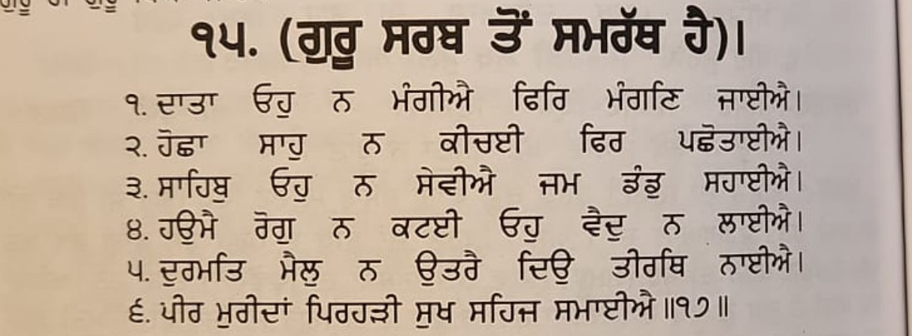
Mr. Chahal says BJP/RSS has all the power. The Sikh’s should cooperate or join RSS to get the benefits.
Response: Mr. Chahal is totally ignorant of Sikh principals and Sikh correctors. Two younger sons (Sahibzada) of Guru Gobind Singh. Fateh Singh (7 years old) and Jorawar Singh (9 years old) gave their lives but did not accept all the offers of Sirhand ruler. These RSS Sikh’s are celebrating Bal Diwas but do not understand the meaning of their sacrifice.
Bhai Gurdas

Slide 45
Mr. Chahal brags that he stays in CM Yogi’s house as a guest and has access to Home Minister and Prime Minister of India.
Response: Mr. Chahal does not know Sikh history. Guru Nanak while traveling preferred to stay in the house of Bhai Lalo (a poor carpenter) and refused to eat at the house of Malak Bhago (a wealthy merchant of his time).

Slide 46
Mr. Chahal is asking the Sikh community to support Mr. Modi to get his help.
Response: Mr. Chahal needs to remember that during Indra Gandhi’s emergency, Mr. Modi survived by disguising himself as a Sikh and taking shelter in Gurdwaras.

Slide 47
Mr. Chahal brags that RSS is good for the Sikh community.
Response: Let us review RSS’s contributions
1953 Mr. Mukerji, the first president of BJP accompanied by Mr. Bajpai went to Kashmir to protest against the special privileges given to Kashmir; however, at the Kashmir border he left Bajpai in Punjab to appose Sikh majority state/Punjabi Suba. B.D. Pande, the governor of Punjab, in his book has confirmed the poisiones role of RSS sponsored Jullundar newspapers.
Sikh’s were demanding to remove the cigarette and liquid shops in the vicinity of Golden Temple. BJP/RSS paraded with 10,000 followers around the Golden Temple with cigarettes/Bidis in their hands chanting “cigarette Bidis Peenge, Shan se jeenge”.

Slide 48
Harbans Lal Khana on February 14, 1984 destroyed a model of Golden Temple publicly near railroad station, Amritsar. This shows BJP contempt for Golden Temple.
Prior to Blue Star in 1984, Mr. Lal Krishan Advani led a demonstration demanding that Indra Gandhi should send an army to invade Golden Temple. A picture showing this is in his book titled My Life My Country.
After Blue Star BJP/RSS workers distributed sweets in the streets.
Nana Ji Dhesh Mukh (RSS leader) wrote an article “Moment of Soul Searching”. In this article not only did he praise Indra Gandhi for Operation Blue Star, but he also blamed the Sikh leadership for daily Sikh Carnage/ Genocide.

Slide 49
In 1991 during BJP rule, 10 Sikh’s in Pilibhit were killed; however, no action was taken by the Government.
Modi as a Chief Minister, passed a law in Gujrat taking back the land from the Sikh people in Kach area; however, lost in the high court. After that, BJP workers started harassing the Sikhs’.
During Modi’s rule, Sikhs’ who were settled in Assam, were being uprooted.
During farmers agitation, a Minister’s (Mishra) son ran over the Sikh people in his Jeep and killed several. He was then released without any punishment.
Mr. Modi has been bragging that we will kill (Guskek Marange). He is personally responsible for the killing of Sikh leaders in Lahore, London and Surrey Canada and for authorizing the assassination of Gurpatwant Singh Pannu.

Slide 50
List of Gurdwaras Demolished by the RSS/BJP
Mechuka in Arunachal Pradesh
Gyan Godri in Hardwar
Nanakbari in Hardwar
Gurdwara Nanak Bari near Reetha Sahib in Uttarakhand
Gurdwara Nanak Padao near Reetha Sahib
Gurdwara Almora in Uttarakhand
Gurdwara Paua Sahib
Gwalior related to Guru Gargobind Sahib
Gurdwara Manji Sahib Kalsi Uttarakhand, related to
Guru Gobind Singhji
Gurdwara Smadh Rani Jind Kaur at Ram Kund Nasik, Maharashtra

Slide 51
Sukhi Chahal (RSS Sikh) is only a low-level agent for the Indian government and their San Francisco consulate. He is using his connections to get Visa for someone or passport renewal etc. beyond that he has no power.
If he truly has any power, he should:
Get article 25 reappealed
Get Chandigarh to Punjab
Get Bhakhra Dam back to Punjab
Free Punjab University from the Center
Free Bandi Singhs’ who already have served their sentence
This list can be very long

Slide 52
Truly speaking there is no democracy in Punjab/India
Governor of Punjab is not elected by the people of Punjab
Prime Minister Modi has not won any election in Punjab
President of India has not been directly elected by the people of Punjab
Now they have sent an RSS agent disguised as a Sikh to deceive and exploit the Sikh Diaspora
We, the Sikh in the USA will not allow this to continue

